Slide 1
Global burden of disease study : Past, present, and future
Christopher J.L. Murray
November 9, 2016

Slide 2
Outline
GBD overview and evolution
Some key results from GBD 2015
New analytical directions

Slide 3
Global Burden of Disease today
A systematic, scientific effort to quantify the comparative magnitude of health loss from all major diseases, injuries, and risk factors by age, sex, and population and over time.
Goal is to inform decision-makers at every level (local, regional, national and global) with the best evidence on levels, trends and drivers of health so that decisions are ultimately more evidence-based.

Slide 4
Global Burden of Disease today (II)
Covers 195 countries and territories from 1990 to present. Sub-national assessments for some countries including China, Mexico, UK, US, Brazil, Japan, India, Saudi Arabia, Kenya, South Africa
315 diseases and injuries, 2,619 sequelae, 79 risk factors or clusters of risk factors.
Updated annually; release in September each year.
Findings published in major medical journals, policy reports, and online data visualizations.

Slide 5
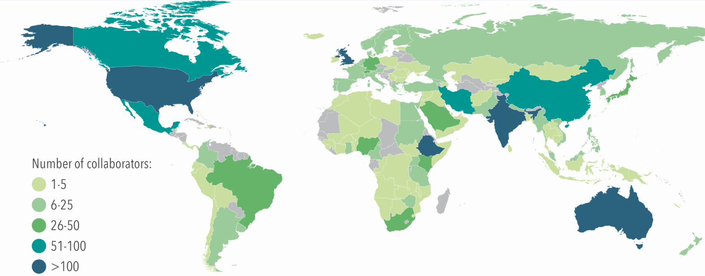
GBD: a global study with a global collaborative network of investigators
1,880 collaborators from 124 countries and 3 non-sovereign territories

Slide 6
GBD: standardized solution to global health measurement challenges
Challenges:
Inconsistent coding and case definitions
No data
Conflicting data
Sampling and non-sampling measurement error
Excluded groups
GBD solutions:
Quality review of all sources and corrections for garbage coding
Cross-walking different case definitions, diagnostic technologies, recall periods, etc., using statistical methods
Statistical methods to deal with missing data, inconsistent data, excluded groups and measurement error

Slide 7
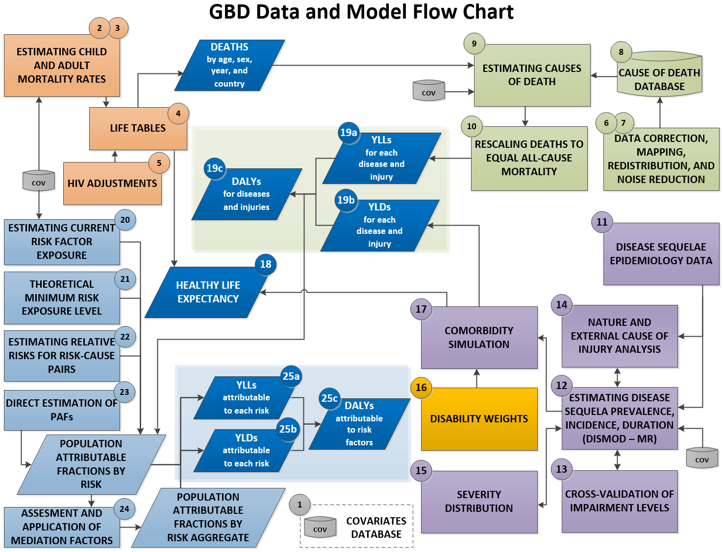

Slide 8
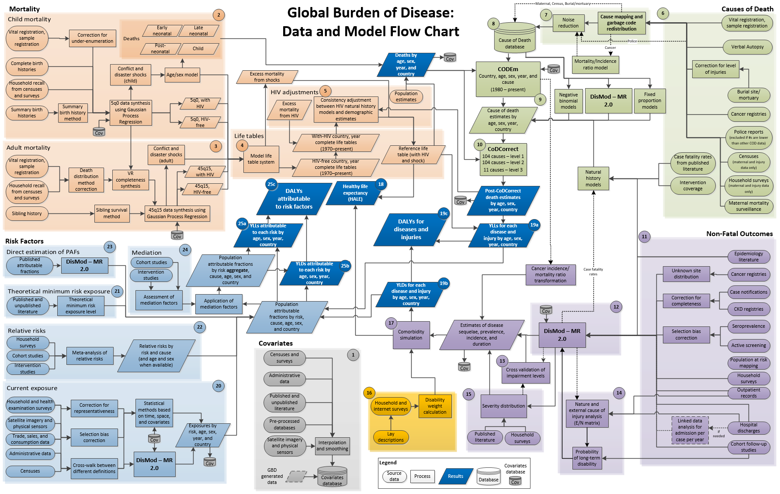

Slide 9
Multiple metrics for health
Traditional metrics: Disease and injury prevalence and incidence, death numbers and rates.
Years of life lost due to premature mortality (YLLs) – count the number of years lost at each age compared to a reference life expectancy of 86 at birth.
Years lived with disability (YLDs) for a cause in an age-sex group equals the prevalence of the condition times the disability weight for that condition.
Disability-adjusted life years (DALYs) are the sum of YLLs and YLDs and are an overall metric of the burden of disease.
Healthy life expectancy (HALE) is a positive summary measure counting the expected years of life in full health.

Slide 10
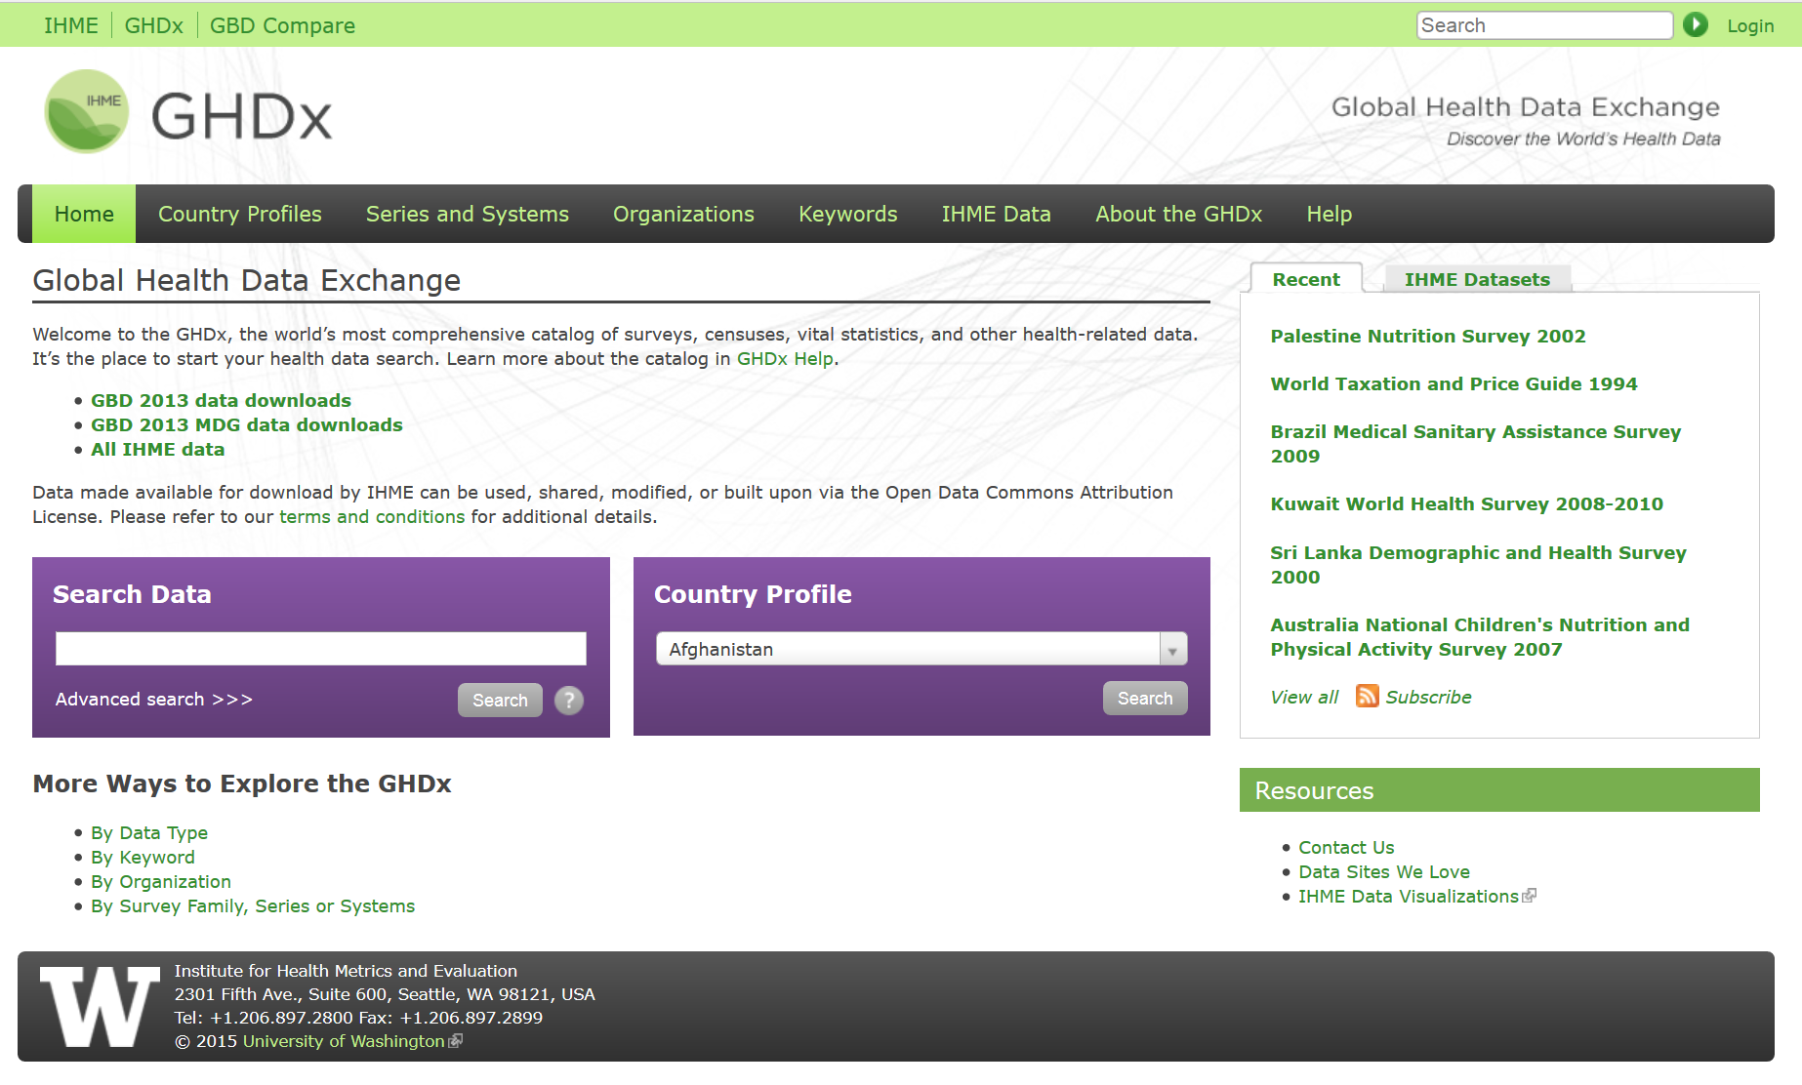
All data sources in the GBD indexes in on-line catalog with metadata on 60,000+ GBD sources

Slide 11
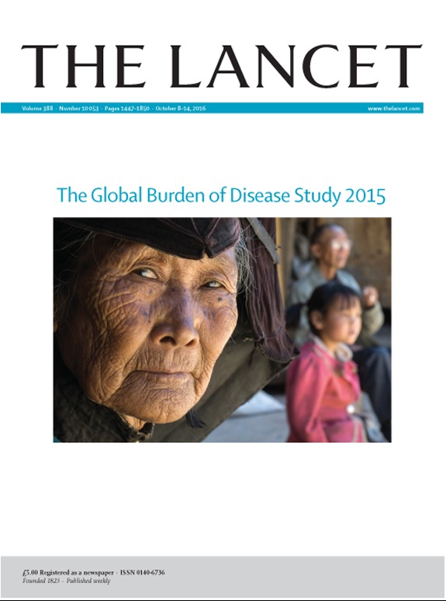

Slide 12
GBD as a dynamic scientific enterprise
Five cycles of GBD estimation: GBD 1990, GBD 1999-2004, GBD 2010, GBD 2013 and GBD 2015.
Cause list: 109 causes GBD 1990 315 causes for GBD 2015.
Risks: 10 risks in GBD 1990 79 risks in GBD 2015
Locations: 8 regions in GBD 1990 195 countries/territories more than 500 subnational locations in GBD 2015
Data processing: GBD 1990 redistribution for ill-defined causes of death to statistical cross-walking and detailed garbage code redistribution
Estimation methods: plausible internally consistent point estimates in GBD 1990 to posterior distributions for each quantity using Bayesian inference.
Disability weights: GBD 1990 expert panels population-based surveys in multiple countries for GBD 2010 and beyond.

Slide 13
Outline
GBD overview and evolution
Some key results from GBD 2015
New analytical directions

Slide 14
Socio-Demographic Index (SDI) quintiles by GBD subnational level 1 geography, 2015. SDI is meant to place locations on the development continuum based on income per capita, average years of schooling and total fertility rate.

Slide 15
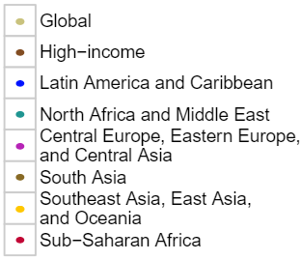
Life expectancy at birth and SDI. Black line shows average relationship 1980-2015 and points show the co-evolution of life expectancy and SDI for GBD super-regions

Slide 16
Expected relationship between age-standardized YLL rates by cause, SDI and sex
Notes:
Expected relationship between age-standardised YLL rates per 100 000 people for the 21 GBD Level 2 causes and SDI (A), the expected relationship between population and SDI (B), and the expected relationship between all-age YLL rates per 100 000 people for the 21 GBD Level 2 causes and SDI (C), by sex The stacked curves in A and C represent the average relationship between SDI and each cause of YLLs observed across all geographies over the time period 1980 to 2015. In each fi gure, the y-axis spans from the lowest SDI up to the highest SDI. To the left of the midline are male rates, and the female rates are to the right; higher rates are further from the midline

Slide 17
Expected relationship between population and SDI
Notes:
Expected relationship between age-standardised YLL rates per 100 000 people for the 21 GBD Level 2 causes and SDI (A), the expected relationship between population and SDI (B), and the expected relationship between all-age YLL rates per 100 000 people for the 21 GBD Level 2 causes and SDI (C), by sex The stacked curves in A and C represent the average relationship between SDI and each cause of YLLs observed across all geographies over the time period 1980 to 2015. In each fi gure, the y-axis spans from the lowest SDI up to the highest SDI. To the left of the midline are male rates, and the female rates are to the right; higher rates are further from the midline

Slide 18
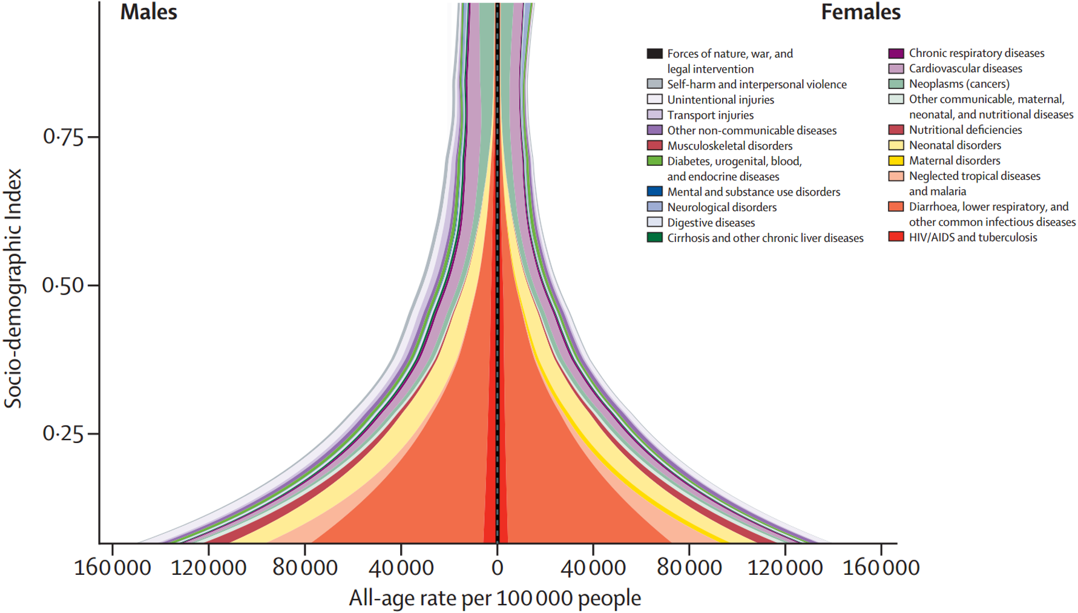
Expected relationship between all-age YLL rates by cause, SDI and sex
Notes:
Expected relationship between age-standardised YLL rates per 100 000 people for the 21 GBD Level 2 causes and SDI (A), the expected relationship between population and SDI (B), and the expected relationship between all-age YLL rates per 100 000 people for the 21 GBD Level 2 causes and SDI (C), by sex The stacked curves in A and C represent the average relationship between SDI and each cause of YLLs observed across all geographies over the time period 1980 to 2015. In each fi gure, the y-axis spans from the lowest SDI up to the highest SDI. To the left of the midline are male rates, and the female rates are to the right; higher rates are further from the midline

Slide 19
Expected relationship between age-standardized YLD rates by cause, SDI and sex
Notes:
Expected relationship between age-standardised years lived with disability (YLD) rates per 100 000 people for the 21 GBD Level 2 causes and SDI (A) and the expected relationship between all-age years lived with disability (YLD) rates per 100 000 people for the 21 GBD Level 2 causes and SDI (B) by sex These stacked curves represent the average relationship between SDI and each cause of YLDs observed across all geographies over the time period 1990 to 2015. In each fi gure, the y-axis spans from lowest SDI up to highest SDI. To the left of the midline are male rates, and the female rates are to the right; higher rates are further from the midline

Slide 20
Expected relationship between all-age YLD rates by cause, SDI and sex
Notes:
Expected relationship between age-standardised years lived with disability (YLD) rates per 100 000 people for the 21 GBD Level 2 causes and SDI (A) and the expected relationship between all-age years lived with disability (YLD) rates per 100 000 people for the 21 GBD Level 2 causes and SDI (B) by sex These stacked curves represent the average relationship between SDI and each cause of YLDs observed across all geographies over the time period 1990 to 2015. In each fi gure, the y-axis spans from lowest SDI up to highest SDI. To the left of the midline are male rates, and the female rates are to the right; higher rates are further from the midline

Slide 21
Global DALYs by Level 1 GBD causes 1990 to 2015. Panel A: numbers of DALYs; Panel B: all-age DALY rates and Panel C: age-standardized DALY rates
Numbers
All-age rates
Age-standardized rates

Slide 22
Leading 30 causes of global DALYs for both sexes combined, 1990, 2005, 2015

Slide 23
Observed vs expected age-standardized DALY rates per 100,000 based on SDI alone for both sexes combined, 2015
Notes:
Ratio of observed versus expected age-standardised DALY rates (per 100 000) on the basis of SDI alone for both sexes combined, 2015

Slide 24
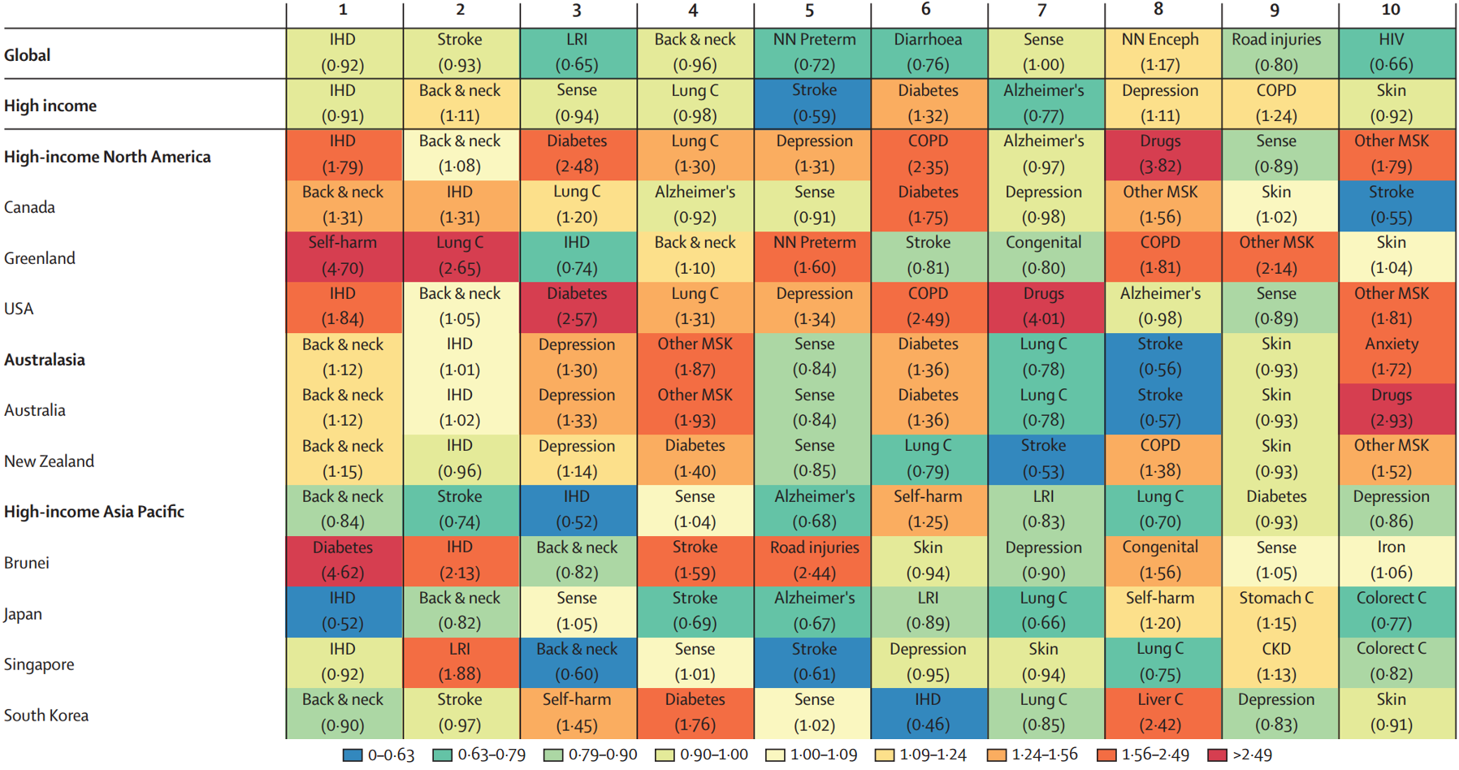
Leading ten causes of DALYs with the ratio of observed DALYs to DALYs expected on the basis of SDI in 2015, by location

Slide 25
Global proportion of all-cause DALYs attributable to risk factors, and overlaps by region, both sexes, 2015
Notes:
Global proportion of all-cause DALYs attributable to behavioural, environmental and occupational, and metabolic risk factors and their overlaps by region for both sexes combined in 2015

Slide 26
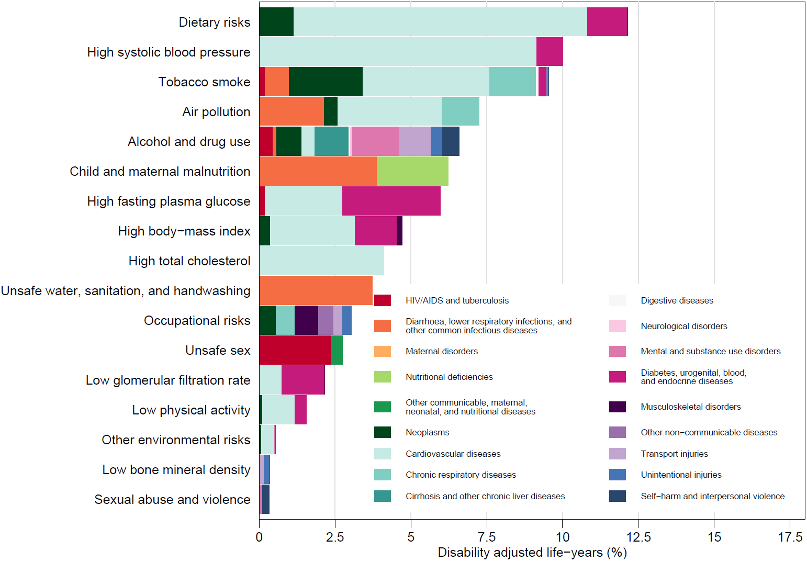
Global DALYs attributable to level 2 risk factors for males, 2015

Slide 27
Global DALYs attributable to level 2 risk factors for females, 2015

Slide 28
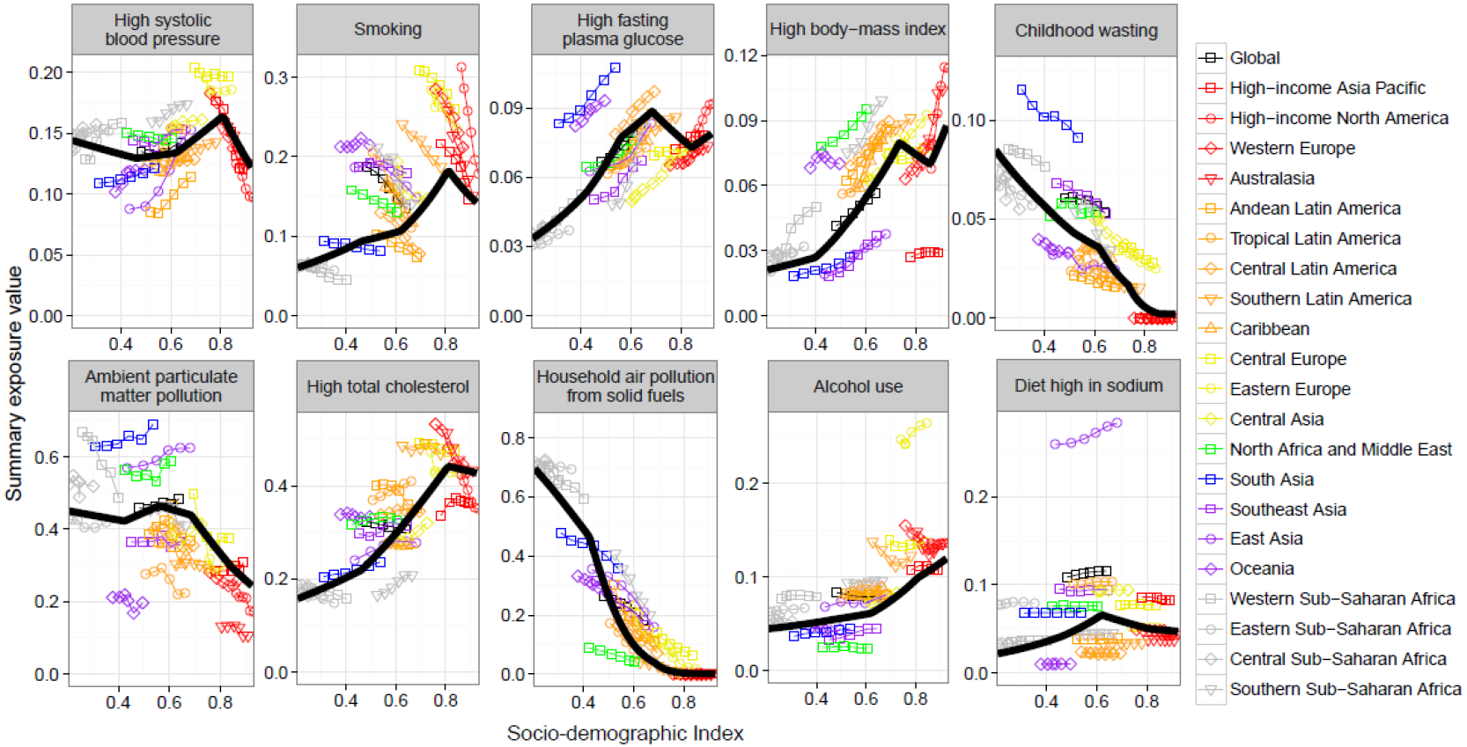
Summary exposure value and SDI for top global risks in terms of attributable DALYs in 2015, with comparisons to expected summary exposure value on basis of SDI

Slide 29
Global decomposition of changes in DALYs attributable to risk factors, 1990-2015 due to population growth and ageing, risk exposure and the risk-deleted DALY rate

Slide 30
Data viz
www.healthdata.org

Slide 31
Outline
GBD overview and evolution
Some key results from GBD 2015
New analytical directions

Slide 32
New directions for the GBD and related analytics
Broadly, the goal of the GBD is to help decision-makers make better decisions. We are continuing to expand a number of directions to enhance the interpretability and relevance of the GBD results for different users.
Healthcare quality and access measured using mortality highly amenable to health care
Absolute and relative avertable burden
Forecasts of the GBD 25 years into the future by location
Finer grained spatial estimation: 2nd administrative level or 5x5 km pixel level.
Health expenditure by GBD cause/risk

Slide 33
Health system access and quality, 2015
Using the set of causes highly amenable to healthcare e.g. testicular cancer, chronic kidney disease or tuberculosis, to proxy access to high quality healthcare. Rates are risk standardized.

Slide 34
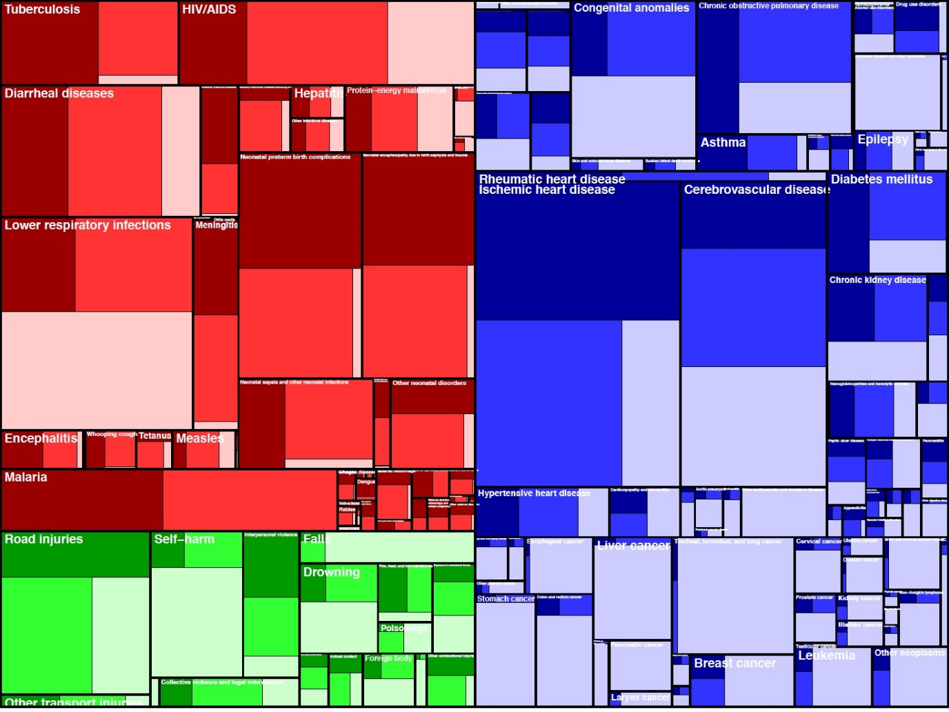
Potential of healthcare to reduce premature mortality
Estimate the absolute fraction of each cause that could be averted through high quality healthcare and the fraction relative to level of development.
Treemap of global deaths in 2015. Dark color is avertable through healthcare relative to development level, intermediate color is avertable through highest quality healthcare, light shade not avertable through healthcare

Slide 35
Two distinct goals for health futures platform
Generate and regularly update past trends and relationships scenario (PTRS) for mortality, morbidity and population from now to 25 years in the future by age, sex, cause and GBD geographies (over 500 now)
Create a comprehensive framework to assess alternative scenarios of interest to relevant stakeholders with different trajectories for independent drivers

Slide 36
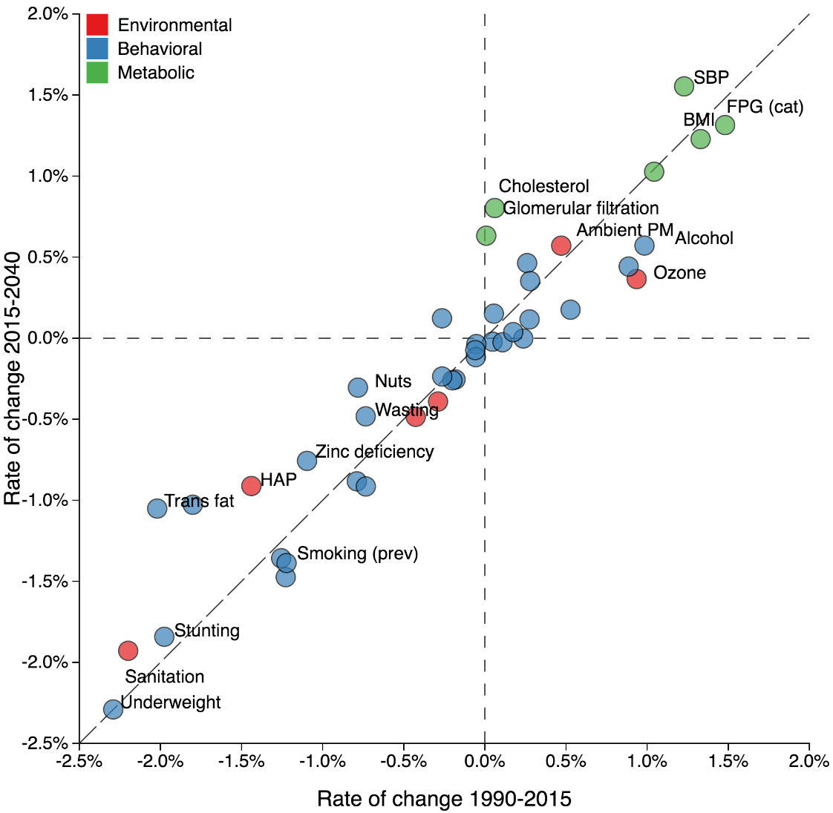
Historic vs projected annualized rate of change in global risk factors

Slide 37
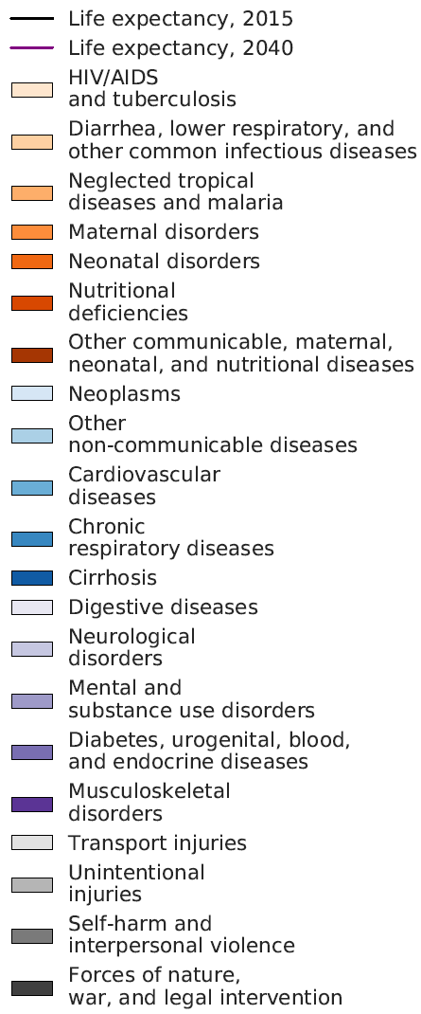
Super-region life expectancy decomposition, females

Slide 38
Super-region life expectancy decomposition, males

Slide 39
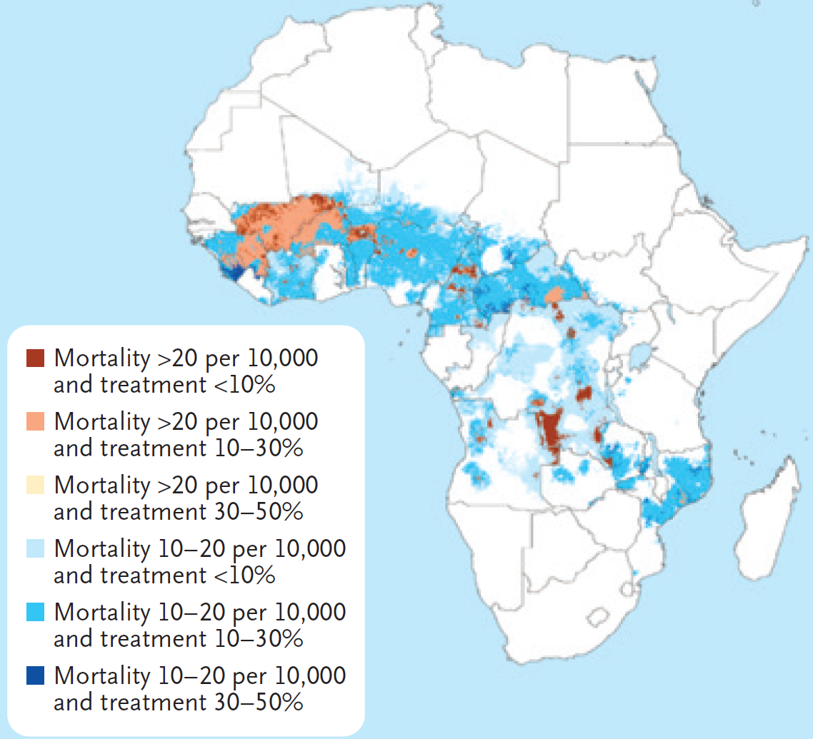
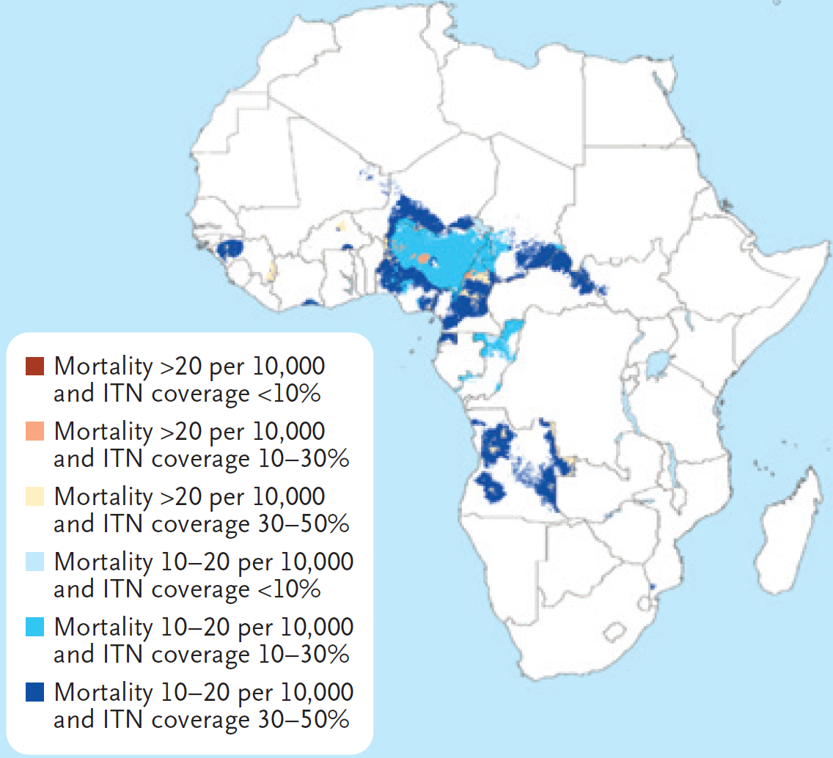
High mortality and low treatment coverage, 2015
Using high resolution maps to target interventions: malaria in sub-Saharan Africa
High mortality and low bed-net coverage, 2015
NEJM, 2016

Slide 40
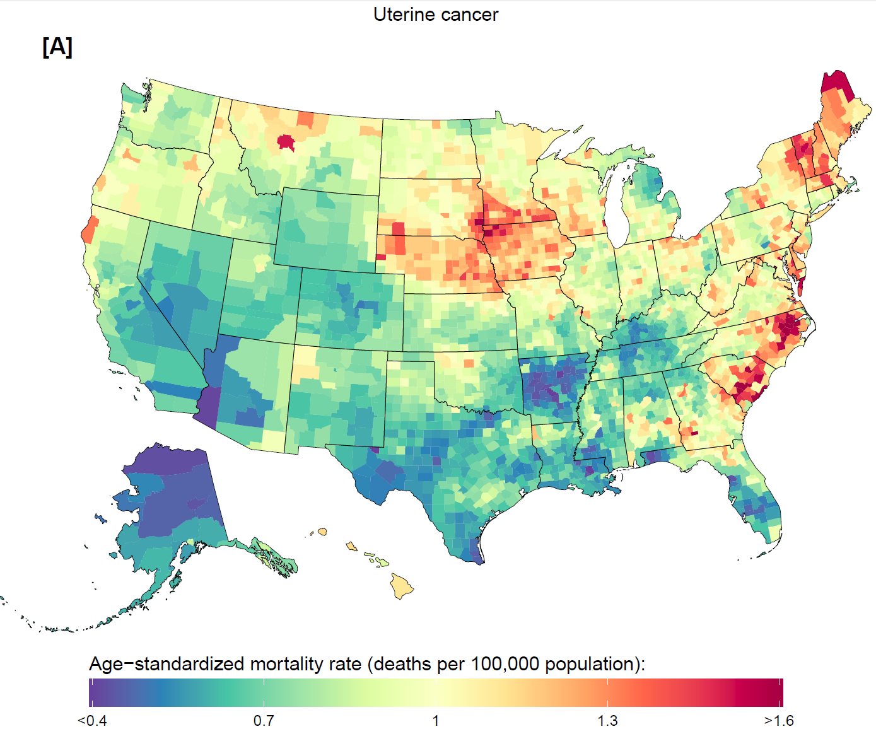
Complete estimation of age, sex, cause, county mortality 1980-2014

