Slide 1
Global Burden of Disease (GBD) Study
Why is it important for Brazil?
Fatima Marinho, MD, MPH, PhD
Director of NCDs,Health Promotion, Information and Health Analysis
Ministry of Health - Brasil
GBD Brasil 2015 Project
Cuernavaca - November 2016

Slide 2
Brazil has been changing its socioeconomic profile quickly
Health services coverage has improved during the last 10 years
Health Data has improved

Slide 3
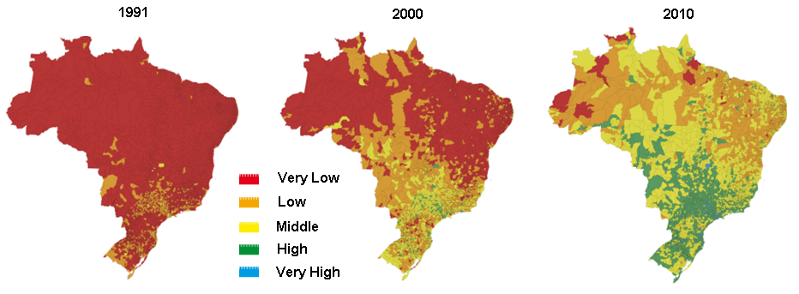
Figure: Human Development Index of Brazilian Municipalities, 1991-2010.
Human Development Index

Slide 4
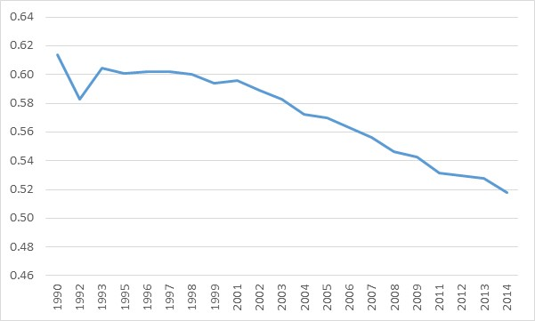
Income Inequality
Trend in income inequality measured by Gini index in Brazil , 1990-2014
Source: IPEA

Slide 5
Family Health Program Coverage
Trends in municipal Family Health Program coverage according to quintiles of municipal HDI.
Data Source: SIAB
Note: The small graph refers absolute difference and rate ratio between the richer and the poorer quintiles.
Notes:
Acerscenar 60 ou mais

Slide 6
The GBD 2015 Project in Brazil: a partnership among the Ministry of Health (MoH) and academics
Close collaboration between the Brazil GBD team (MoH and universities) with IHME on the GBD2015 analysis to have better estimates for Brazil and Brazilian states:
    Brasil data sent to IHME by the MoH;
    New population estimates for states by age and sex in 1970-2000 (UFMG and UFRN team)
    IHME estimates of all cause mortality (mortality envelope-to correct undercount of deaths) and causes of death were discussed with Brazilian researchers in several meetings.
MoH financed a Brazilian network with two main objectives:
  producing results to integrate health indicators – what is segmented and vertical
  create knowledge and expertise among academics to contribute in expanding human resources capacity for GBD analysis and create critical resources for informed policy making.

Slide 7
The GBD 2015 Project in Brazil: Organization of the Brazil GBD network
  May2014: agreement proposal between the MoH and IHME
  October2014: Workshop in Brasília (IHME, UK and Mexico researchers, Brazilian researchers)
  November2014: GBD Brasil Project approved in UFMG
  April2015: Workshop in Belo Horizonte (Cedeplar/UFMF) with Prof. Haidong Wang/IHME
  June2015: Funding from the MoH to UFMG
  July-Aug2015: Launching of the GBD Brasil Network and workshops in several cities with Prof Mohsen Naghavi/IHME
  Sep2015May2016: Evaluation of IHME estimates (all cause mortality and causes of death), and workshops to disseminate the GBD study
  June-Aug2016: Workshops and meetings in several cities; training courses in Belo Horizonte (UFMG)
  Sept2016: Workshop to define Brazil GBD articles with Prof Mohsen Naghavi/IHME and collaborators

Slide 8
The GBD 2015 study in Brazil
  First comparison of health loss among Brazilian States using standardized GBD metrics to compare health situation with other countries;
  Data errors and miscoding are corrected, such as undercount of deaths (incompleteness) and underlying cause of deaths registered as garbage codes in the information system.
  By now 78 collaborators from Universities

Slide 9
Mortality according GBD groups
Brazil 2000 - 2015
GBD groups | Adjusted rate by age
 | 2000 | 2015 | variación %
GBD mortality | 983,0 | 786,2 | -20,0
Group I - Infecciosas, maternas, neonatal e desnutrição | 133,3 | 93,9 | -29,6
Group II - Non-communicable diseases | 754,2 | 611,2 | -19,0
Group III - Causa Externa | 95,5 | 81,1 | -15,0

Slide 10
The contribution of the GBD study to track health conditions in Brasil: Premature deaths
Years of life lost (YLLs) is one of the most important metric used in the GBD study.
Data in Figure (arrow diagram) indicate that the epidemiologic transition took place in Brazil during the last 25 years. Diarrheal diseases, from Group 1 of communicable, maternal, newborn, and nutritional conditions, was the leading cause of premature deaths in 1990, and dropped to the 13th place in 2005 and 36th in 2015.
Cardiovascular diseases and injuries are leading causes in 2005 and 2015. But the maintenance of the top five COD from 2005 to 2015 is an indicator of important challenges to the health system, although the age-standardized YLL rates have declined during the period.

Slide 11
Figure-Leading 20 causes of YLLs with median percent change and age-standardized median percent change, all ages, both sexes. Brazil, 1990, 2005, and 2015.
Source: Cause of death GBD Brazil Network and IHME team-Article to be submmited to publication

Slide 12
The contribution of the GBD study to track health conditions in Brasil
Demographic shifts: new challenges for health system;
NCDs were responsible for 76% of all deaths in Brazil in 2015;
Ischemic heart disease and cerebrovascular disease are the first and second leading causes of death;
Although mortality rates decreased over the period 1990 and 2015, there are important differences in risks among states;
The results of the GBD 2015 study demonstrate higher risks in the less developed states of the Northeast region after correction of information bias (undercount of deaths and misclassification).

Slide 13
Figure-Age-standardized rates (per 100,000) for Ischemic heart disease, both sexes, in Brazilian states, 1990 and 2015.
Source: Cause of death Brazil Collaborators-Article to be submmited

Slide 14
Figure -Age-standardized rates (per 100,000) for Cerebrovascular disease, both sexes, in Brazilian states, 1990 and 2015.
Source: Cause of death Brazil Collaborators-Article to be submmited

Slide 15
The contribution of the GBD study to track health conditions in Brasil: DALY

Slide 16
The GBD 2015 study in Brazil: burden of disease associated with levels of national development
  Important development of the GBD2015 study: the Socio-demographic index (SDI)- constructed for each country/subnational region based on the geometric mean of three indicators:
    income per capita (lag dependent income per capita),
    average years of schooling among populations aged 15 or older,
    total fertility rate .
  Countries and subnational areas were classified according to SDIs quintiles
  Expected death rates by age-sex-cause calculated on SDI level.
Source: GBD 2015 Mortality and Causes of Death Collaborators. Global,…Lancet 2106; 388:1459-544)

Slide 17
Socio-Demographic Index (SDI) based on the GBD 2015 study in Brazilian states in 1990 and 2015
Source: Cause of death Brazil Collaborators-Article to be submmited

Slide 18
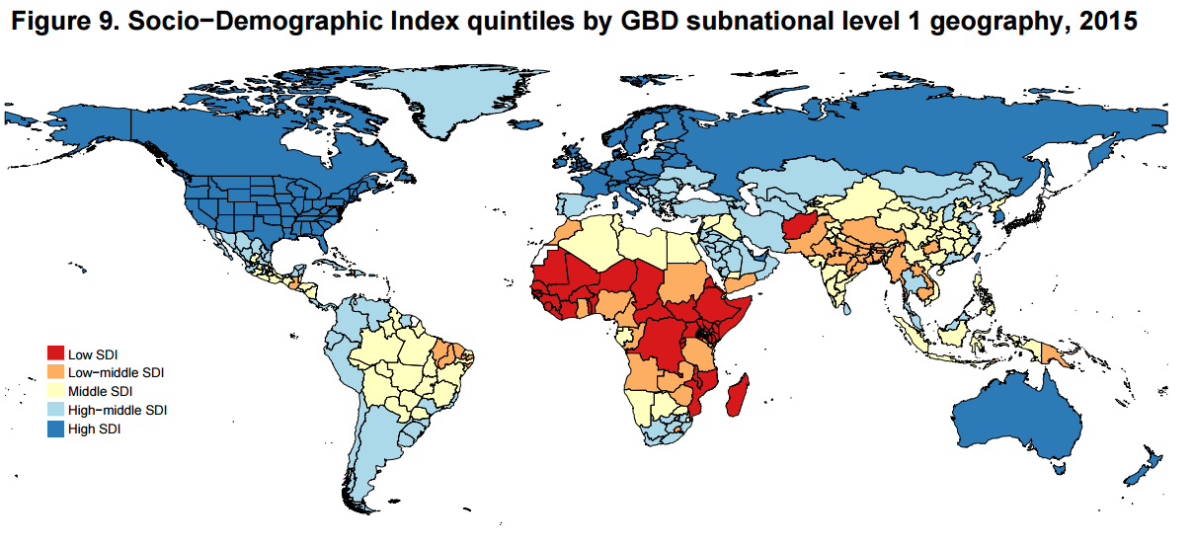
Quintiles of Socio-demographic index (SDI) by GBD geographies, 2015
Source: GBD 2015 Mortality and Causes of Death Collaborators. Global,…Lancet 2106; 388:1459-544)

Slide 19
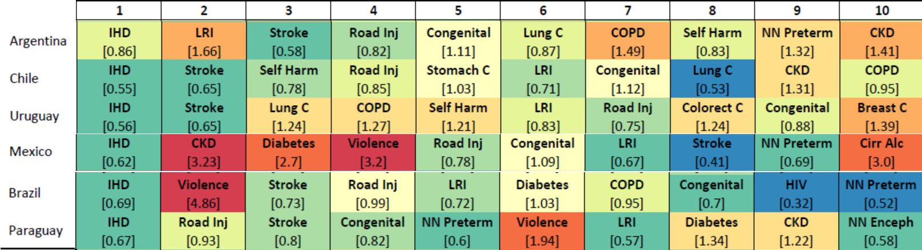
Leading 10 causes of years of life lost (YLLs) with the ratio of observed YLLs to YLLs expected on the basis of Socio-Demographic Index in 2015.
Source: GBD 2015 Mortality and Causes of Death Collaborators. Global,…Lancet 2106; 388:1459-544)

Slide 20
Homicídios cambio de la tasa/100 mil habitantes
Capital e no capital, por grandes regiones, Brasil, 2000 y 2014 (excluído impacto del crecimiento poblacional)
Fonte: SIM/SVS/MS

Slide 21
Working with the GBD approach in Brazil: advances and challenges
  Internal consistency of the GBD estimates and comparability are fundamental for analyzing the state of health in states, measuring disparities between states, and making comparisons with other countries.
  Results of the GBD global are based on an enormous effort to correct information bias, such as undercount of deaths and misclassification due to garbage codes in cause of death analysis.
  Data sources and results are available on the internet (raw data and estimates available in the Viztool), and detailed methods in Appendix.
  Methods and data are improving from each sequential GBD, but GBD estimates are not directly comparable with those from older GBD studies.
  A big challenge: the GBD study uses highly complex demographic and statistical methods, so it is difficult to have independent local replication of all results.
  GBD results may support policy makers and other stakeholders to identify important gaps, measure successes and set new priorities. For example, the MoH is launching a project to investigate all GC (ill-defined R codes and others)
21

Slide 22
What is coming
It is ready for submission all causes death paper by state
A special publication with GBD results will be publish in Portuguese on Brazilian Journal of Epidemiology – in Portuguese
More engagement of MoH technical programs
Increase number of collaborators
Estimates of Zica virus and Chikungunya burden

Slide 23
GBD Brasil 2015
Thank you!
fatima.marinho@saude.gov.br

