Slide 1
Outline
US Burden by State
County analysis

Slide 2
GBD 2015 analysis by state
Vital registration data by state
Hospitalization data by state
Claims data (private and public insurers) by state
BRFSS by state (and county)
Wide variety of risk and disease specific studies

Slide 3
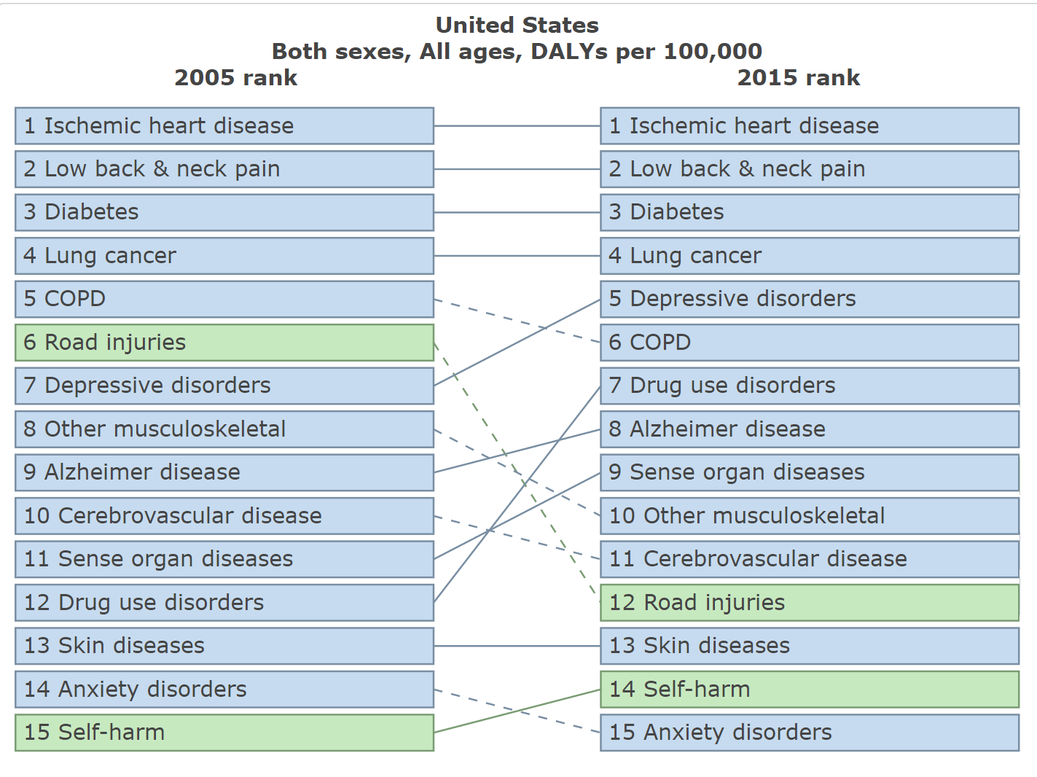
Leading causes of US disease burden

Slide 4
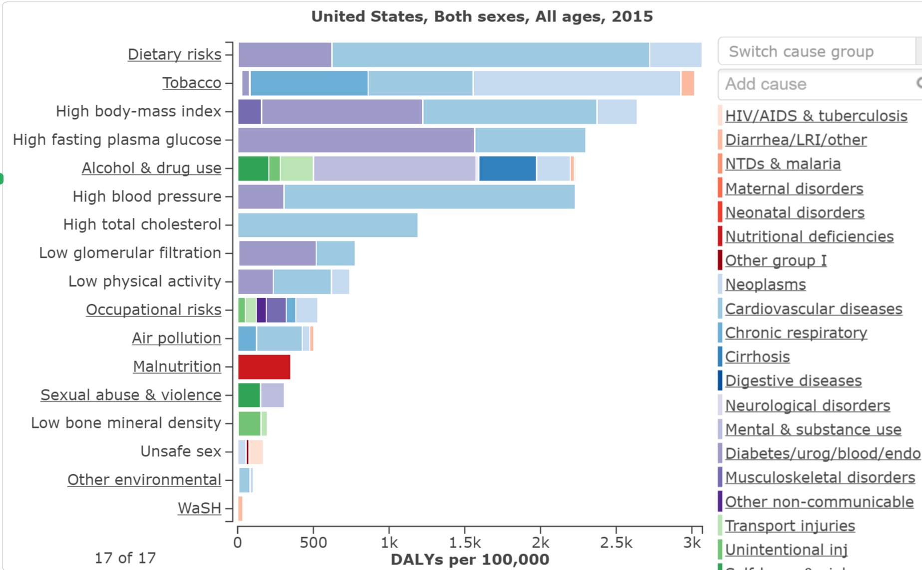

Slide 5
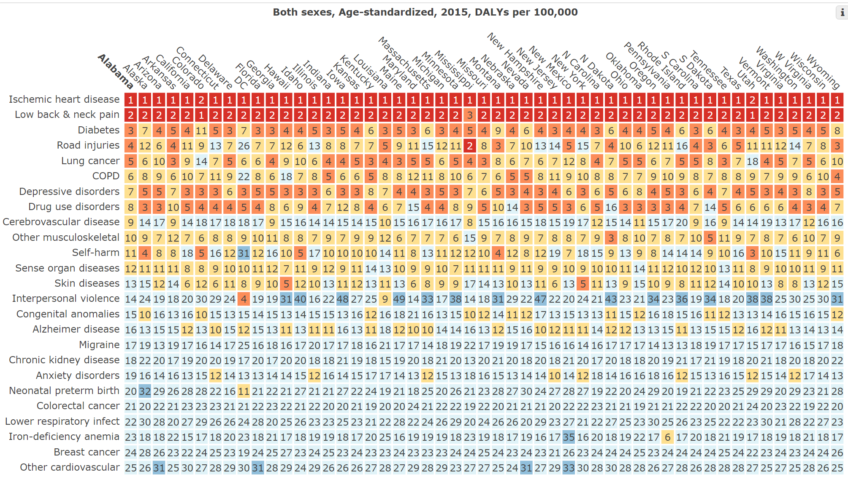
Rank order by states of leading causes of DALYs

Slide 6
Outline
US Burden by State
County analysis

Slide 7
Mortality analysis by county: methodological advancements
In previous iterations of county-level life expectancy estimation, we had to fit separate models by age and year due to computational limitations
With new software (TMB) we are now able to fit much more complex models on data for all years and ages combined
This allows us to capitalize on temporal patterns and age patterns in addition to spatial patterns
Objective validation tests show these models give more accurate estimates (and confidence intervals with better coverage)
This has allowed us to expand beyond analyzing all-cause mortality to cause-specific mortality for 213 causes

Slide 8
Validation framework
Identify a validation set
Calculate the gold standard
Create validation datasets
Fit the model to each validation dataset and generate predictions for the validation set
Compare these predictions to the gold standard and calculate summary error metrics
Bias (mean error, mean relative error).
Precision (mean absolute error, mean absolute relative error, RMSE).
Accuracy of the uncertainty intervals (coverage).

Slide 9
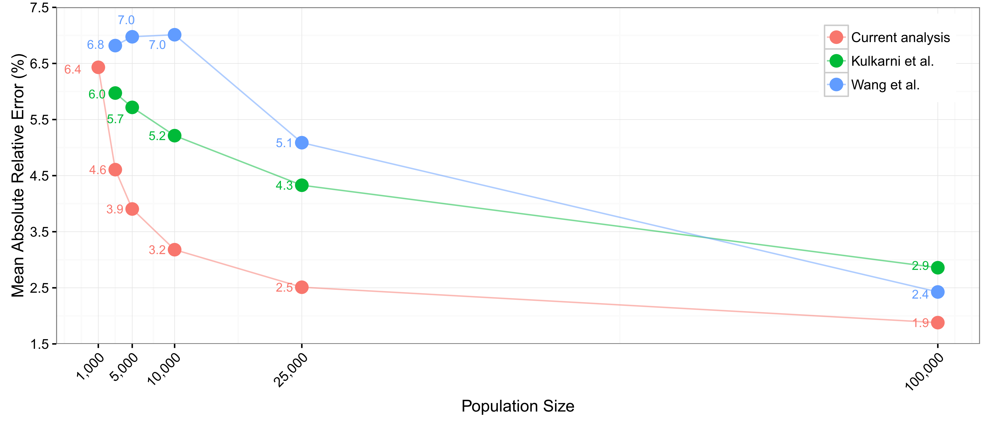
Validation results: precision

Slide 10
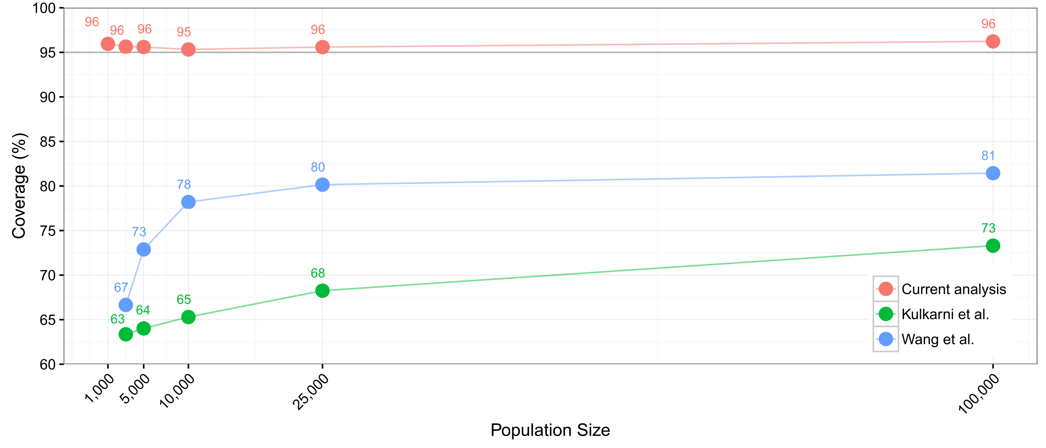
Validation results: coverage

Slide 11
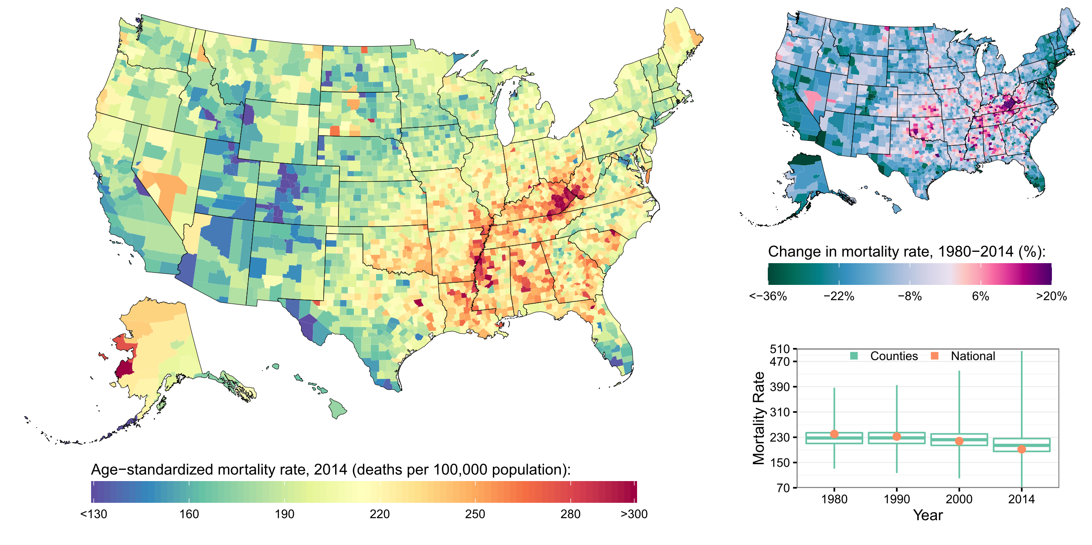
Neoplasms

Slide 12
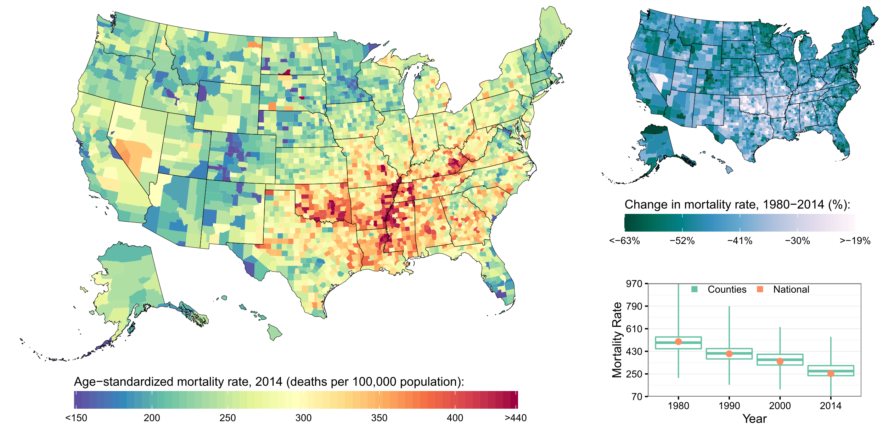
Cardiovascular diseases

Slide 13
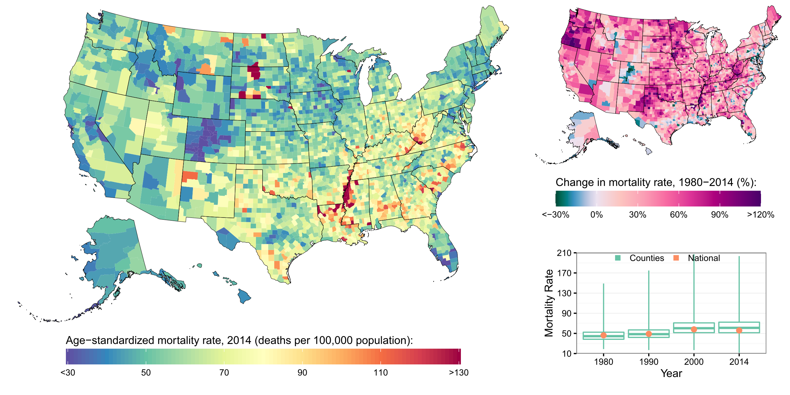
Diabetes, urogenital, blood, and endocrine disorders

Slide 14
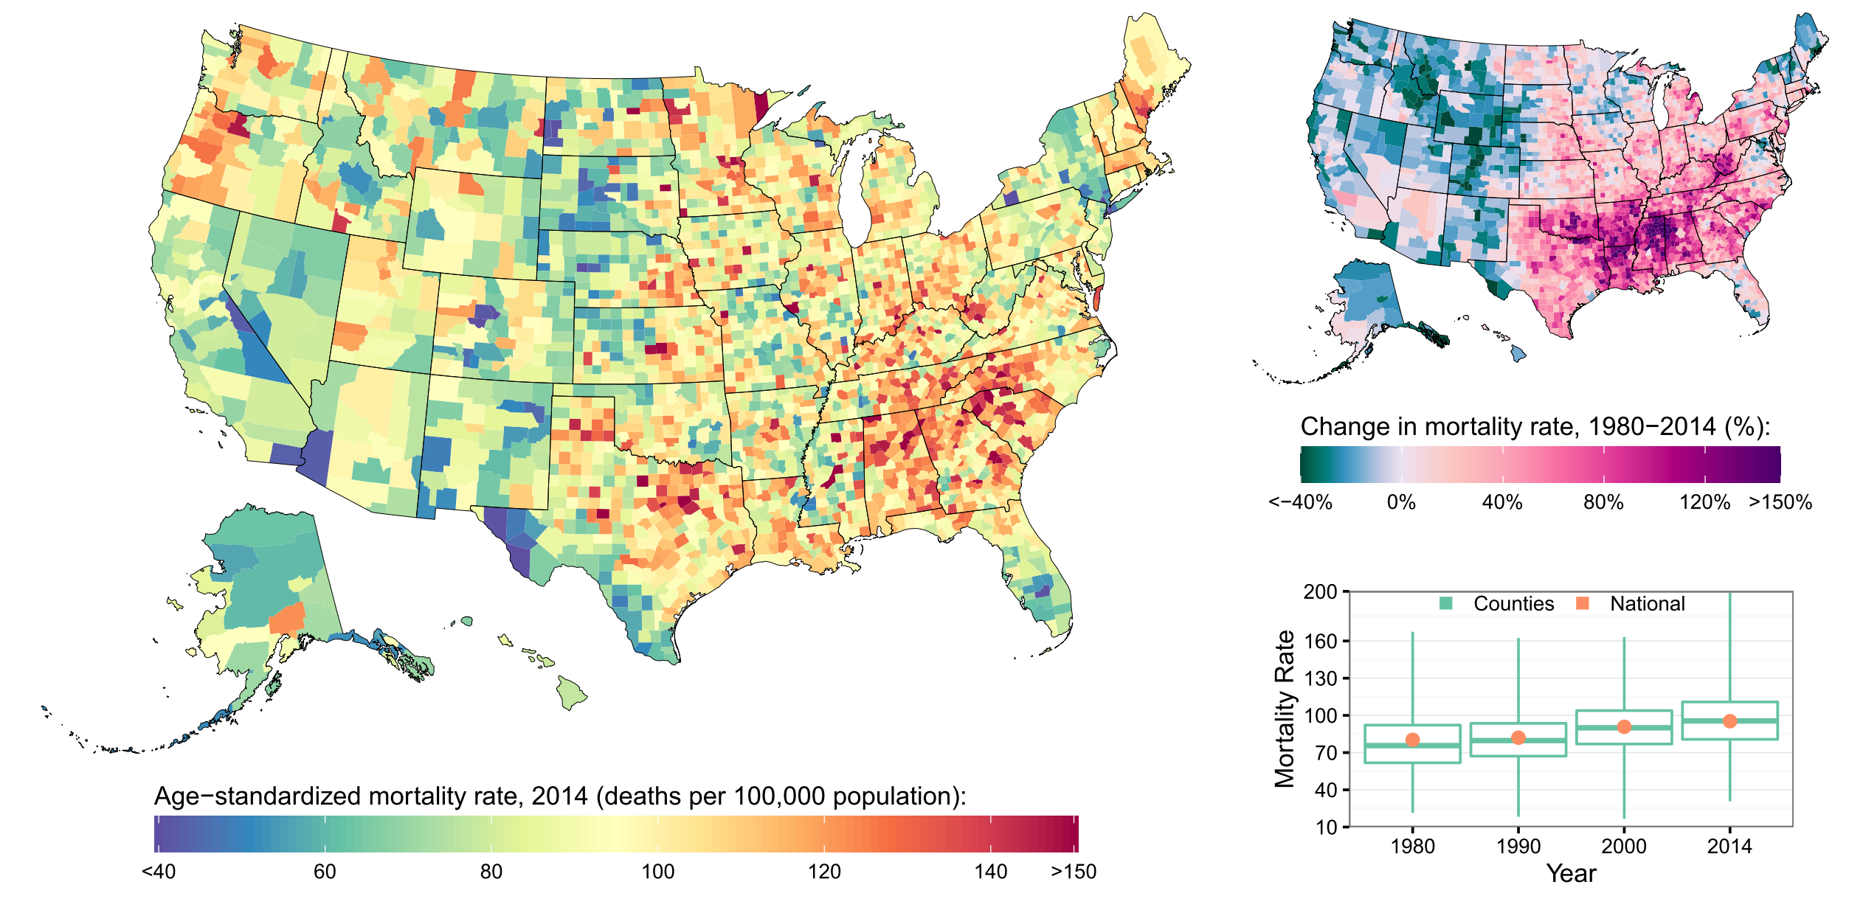
Neurological disorders

Slide 15
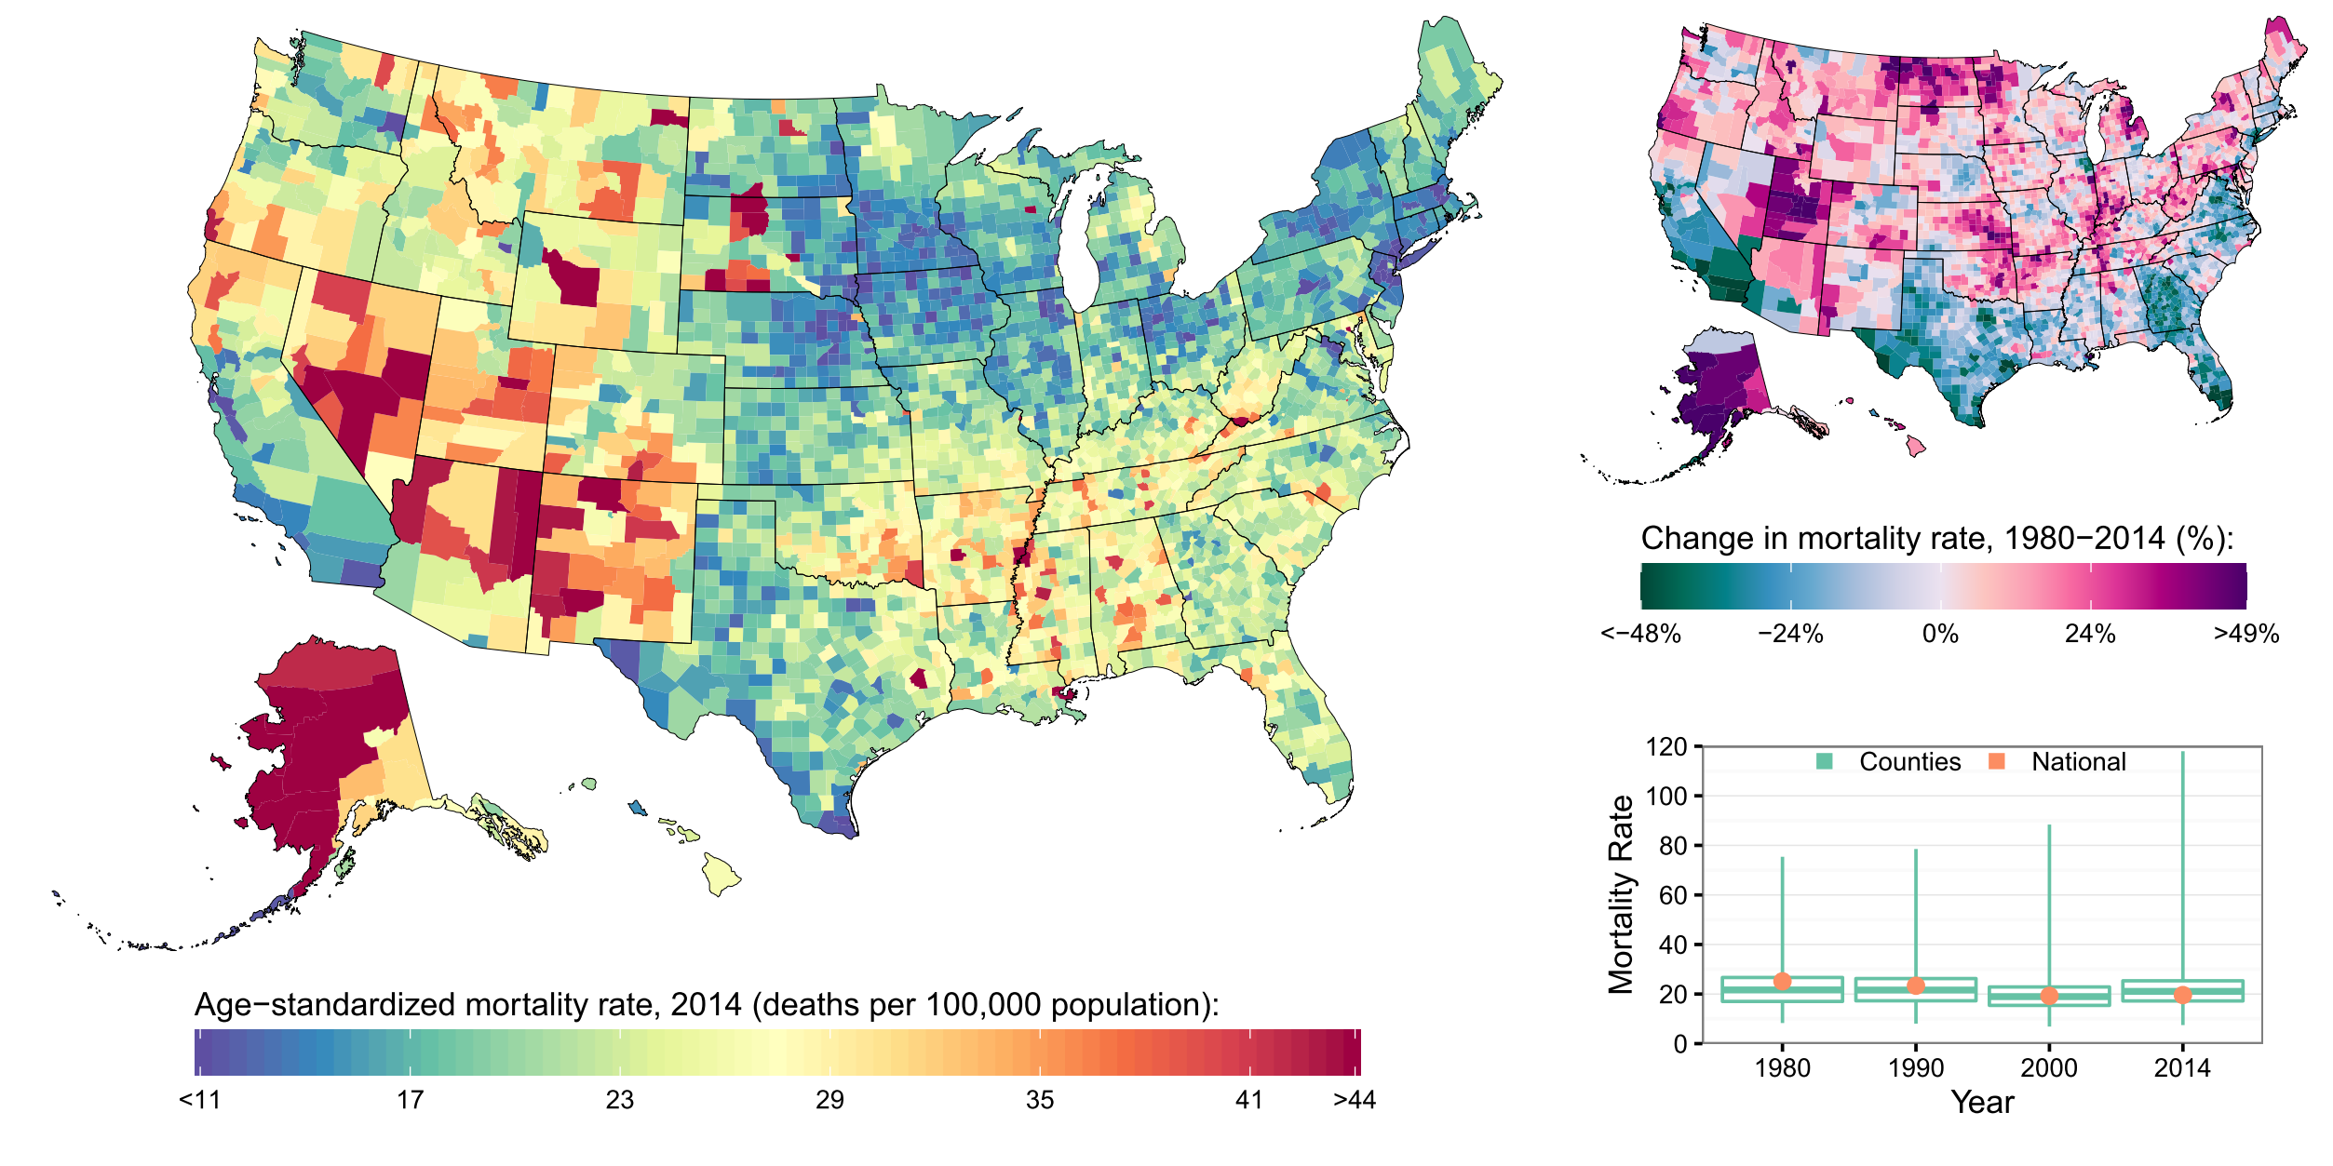
Self-harm and interpersonal violence

Slide 16
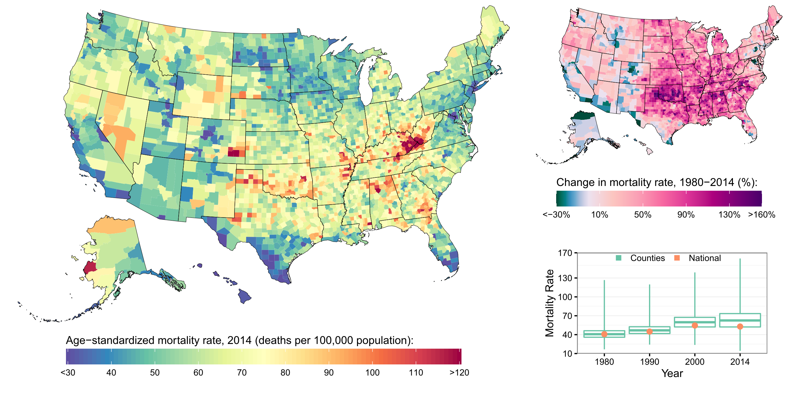
Chronic respiratory diseases

Slide 17
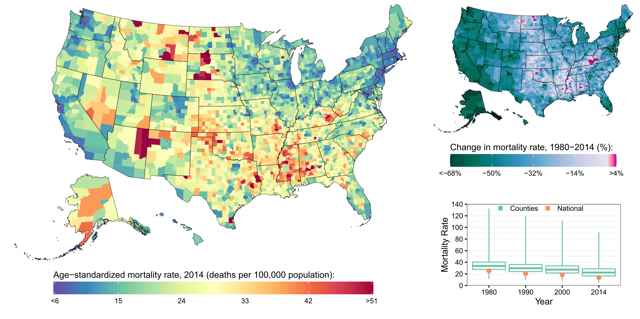
Transport Injuries

Slide 18
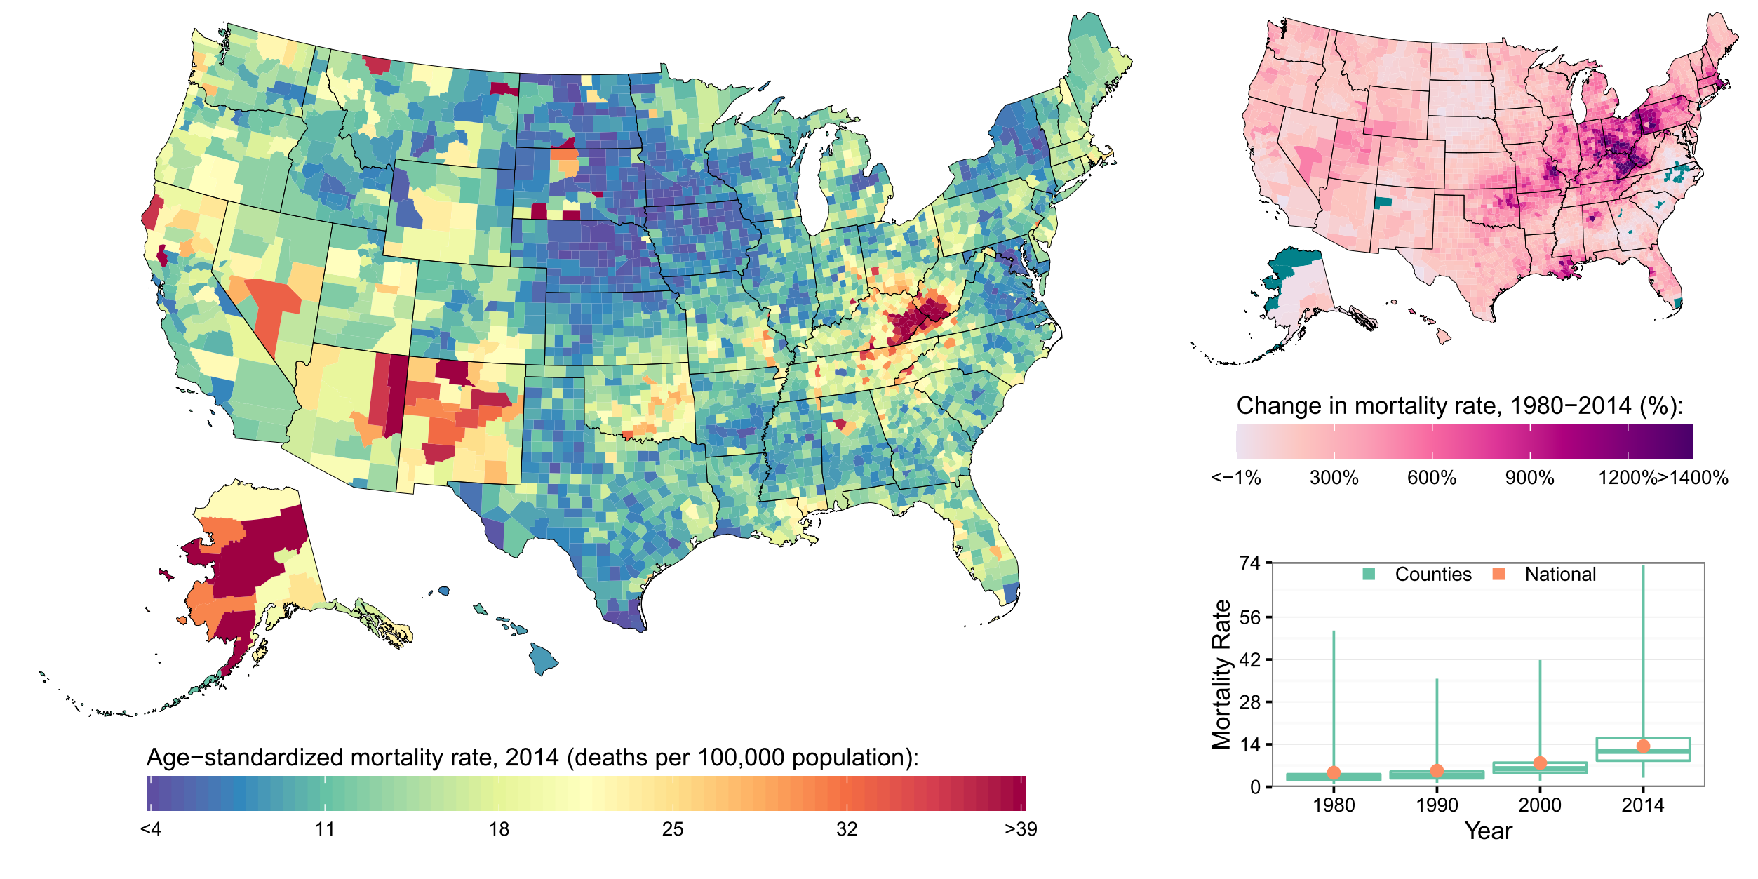
Mental and substance use disorders

Slide 19
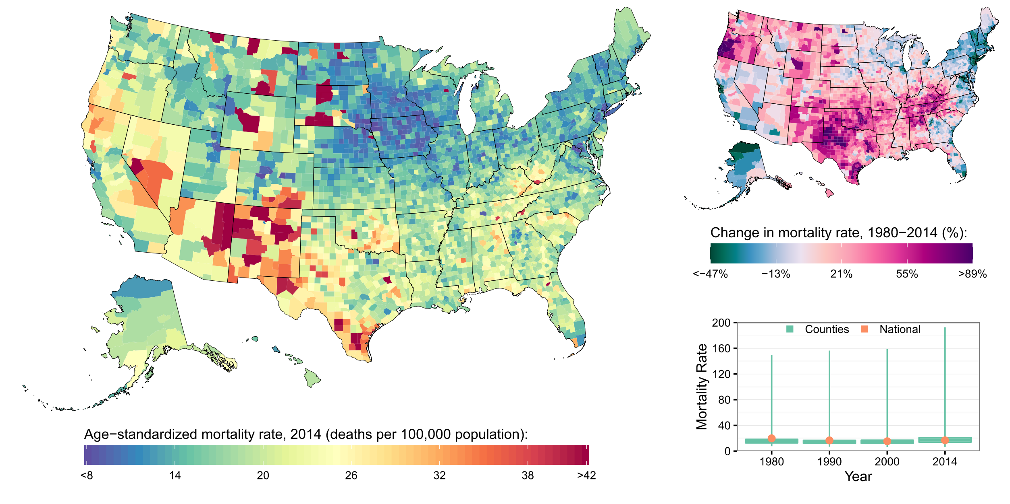
Cirrhosis and other chronic liver diseases

Slide 20
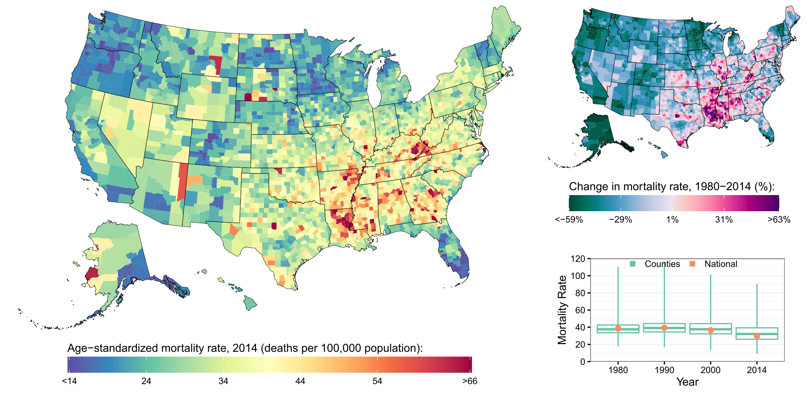
Diarrhea, lower respiratory, and other common infectious diseases

Slide 21
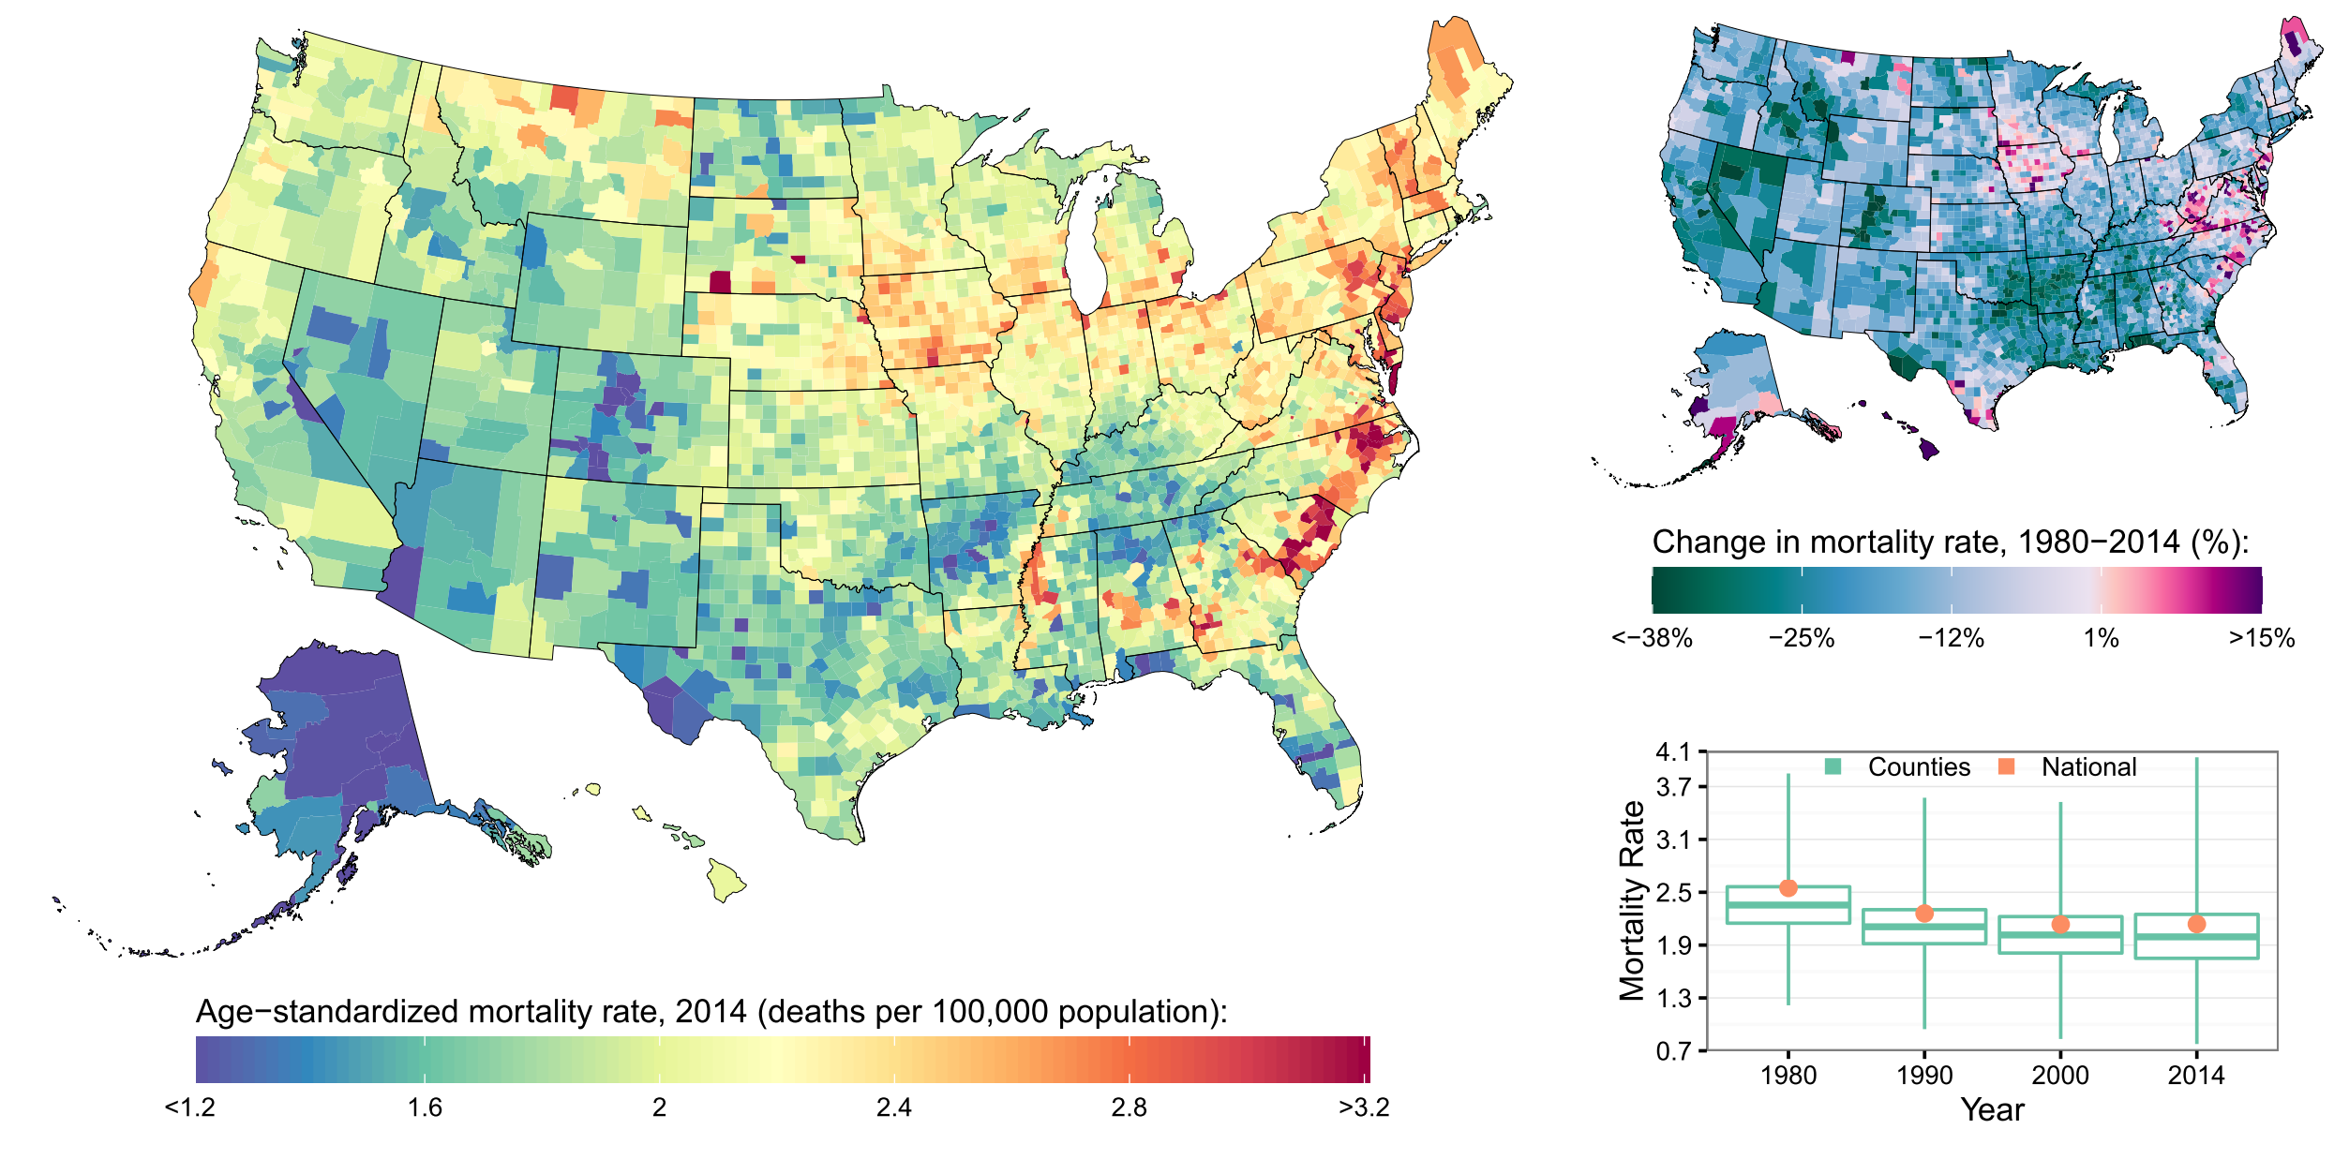
Uterine cancer

Slide 22
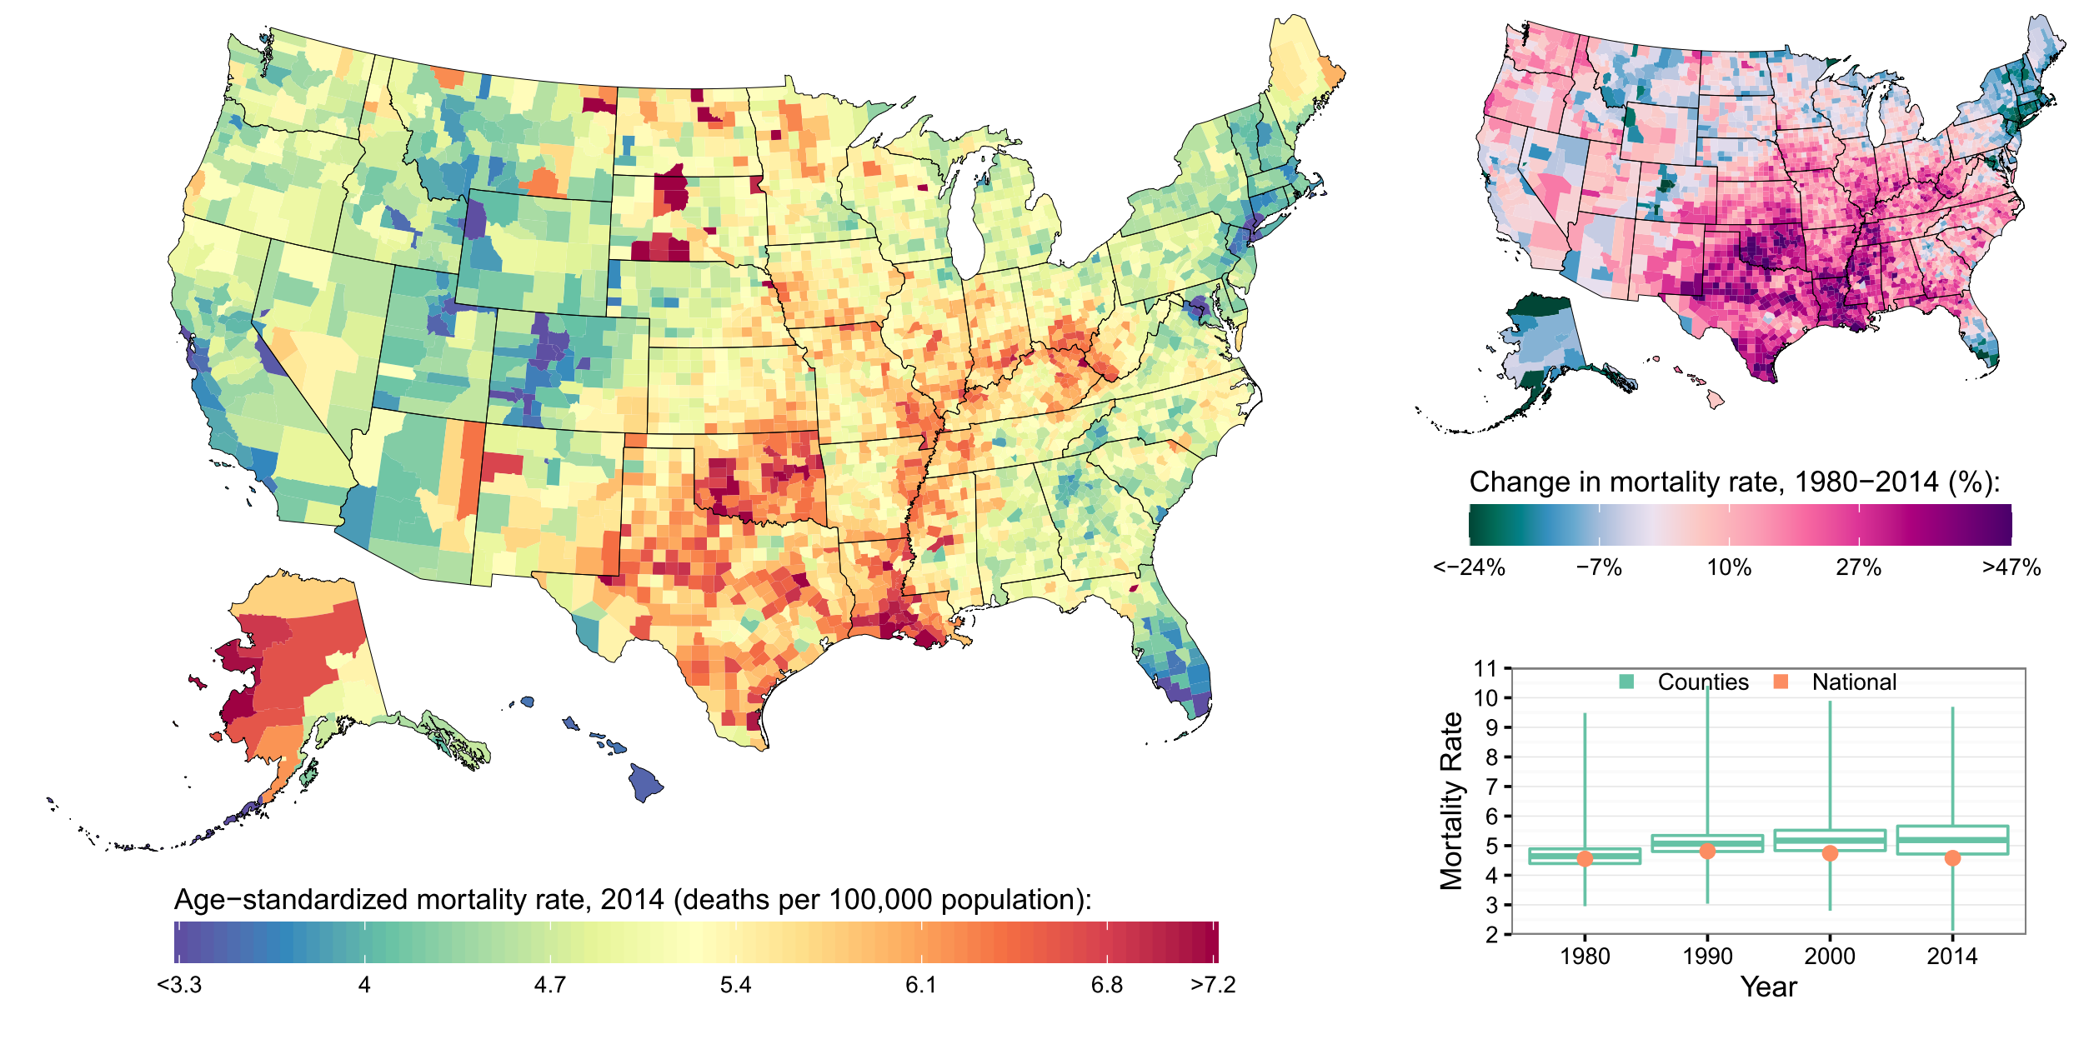
Kidney cancer

Slide 23
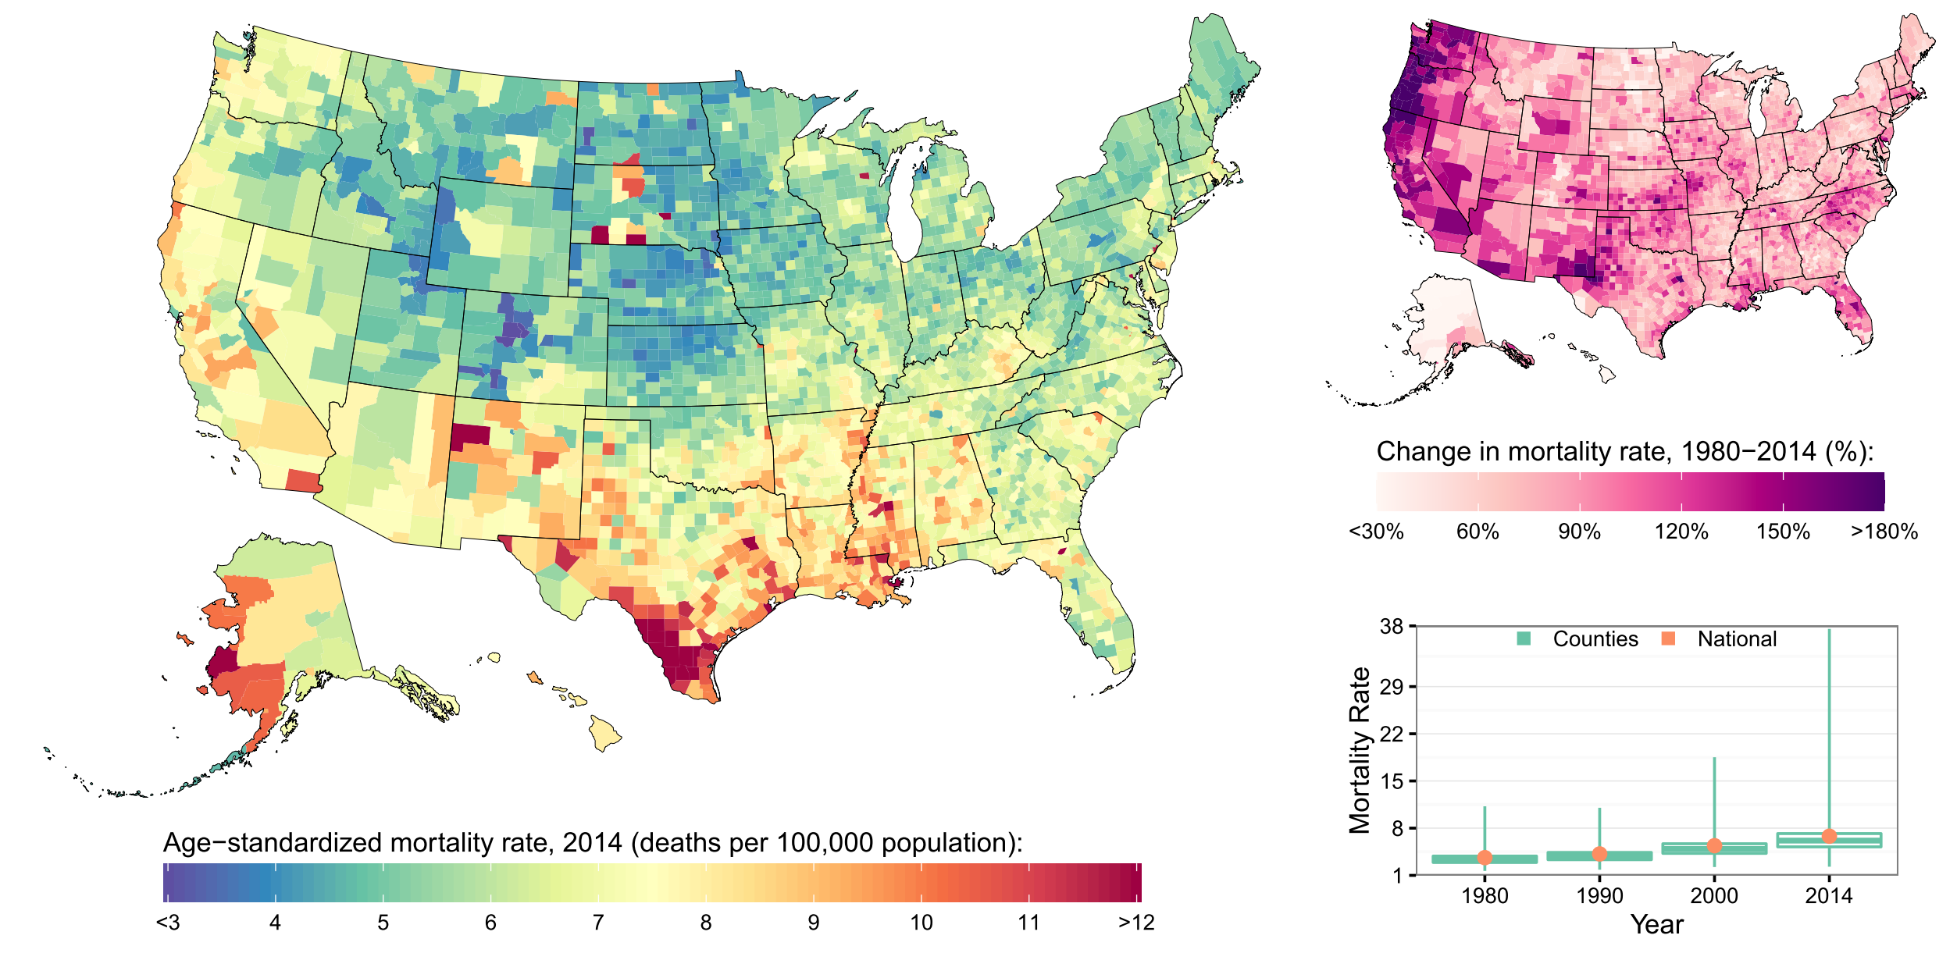
Liver cancer

