Slide 1
Key Findings for India
from
the Global Burden of Disease Study 2015
J.V.R. Prasada Rao
9 November 2016
ICMR

Slide 2
Triple Burden of Disease in India
Unfinished agenda of communicable diseases
Emerging non-communicable diseases
Emerging infectious diseases
With 2.4% of land mass, India supports 17.8% of population which is still growing at 17.7% decadal rate.

Slide 3
The Global Burden of Disease Study Approach
A systematic scientific effort
to quantify the comparative magnitude of health loss
due to diseases, injuries and risk factors
by age, sex and geographies for specific points in time

Slide 4
Global Burden of Disease Study 2015
Estimates of disease burden and risk factors trends produced for 195 countries by GBD Study 2015
Over 1800 collaborators in 120 countries contributed
All available sources of data on mortality, morbidity and risk factors used
Robust methods developed for producing estimates that allow standardized comparisons across countries, age and sex groups, and over time
GBD estimates used widely for academic and policy purposes
Disease burden and risk factors estimates available for India from GBD Study 2015

Slide 5
Relative Per Capita Disease Burden in 2015

Slide 6
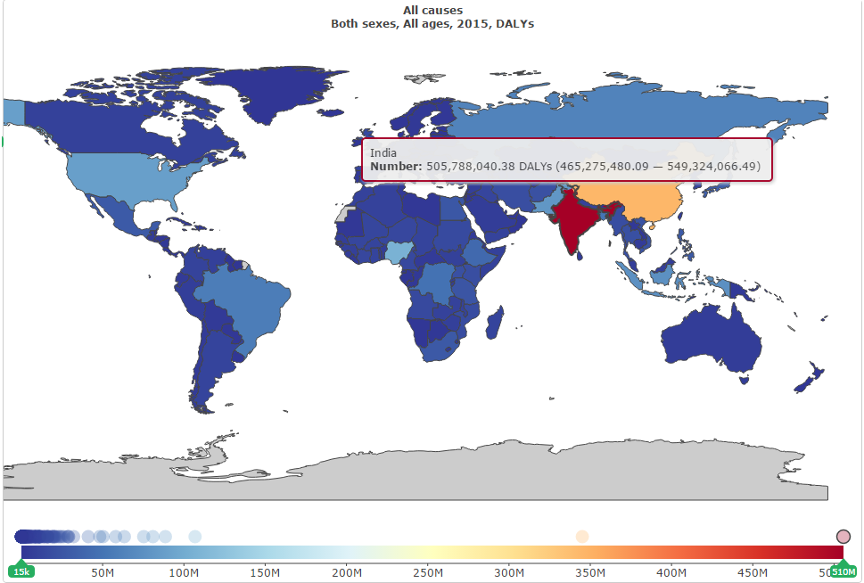
Absolute Number of DALYs in Countries: 2015

Slide 7
Healthy Life Expectancy: 1990 to 2015

Slide 8
Causes of Disease Burden in India: 1990 to 2015

Slide 9
Top 10 Causes for DALYs in India: 1990 to 2015

Slide 10
Top Causes for DALYs Rate in India: 1990 & 2015

Slide 11
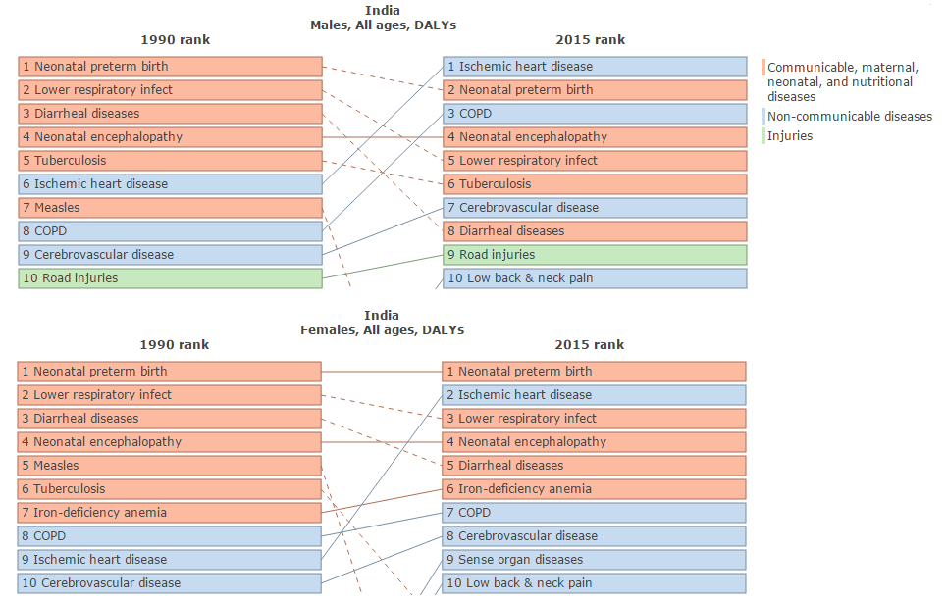
Top Causes for DALYs: Males and Females in India

Slide 12
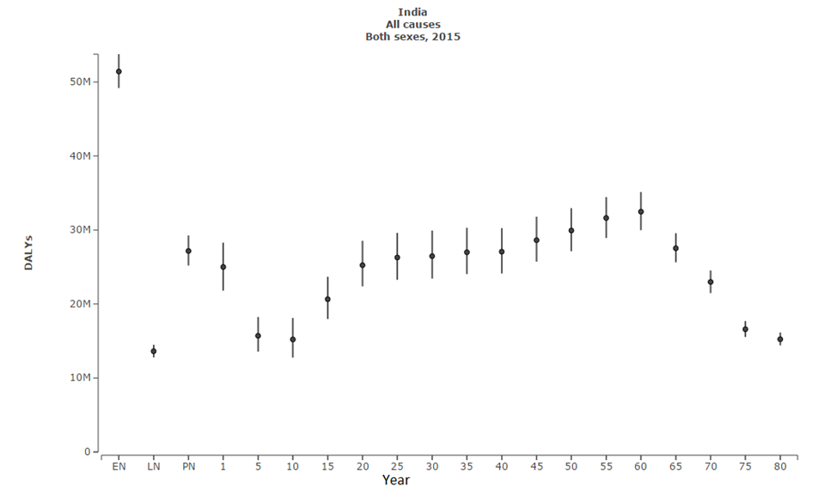
Age Pattern of DALYs in India: 2015

Slide 13
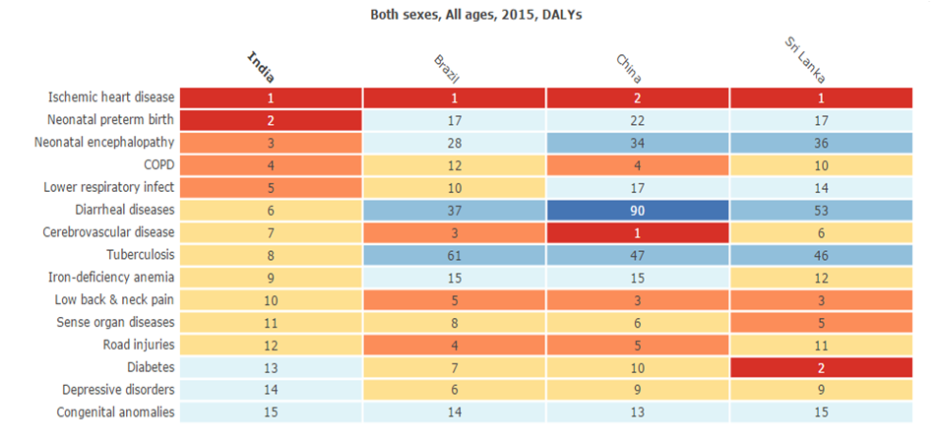
Causes of DALYs Across Countries: 2015

Slide 14
Top 10 Causes for Deaths in India: 2015

Slide 15
Top Causes for Death Rate in India: 2015

Slide 16
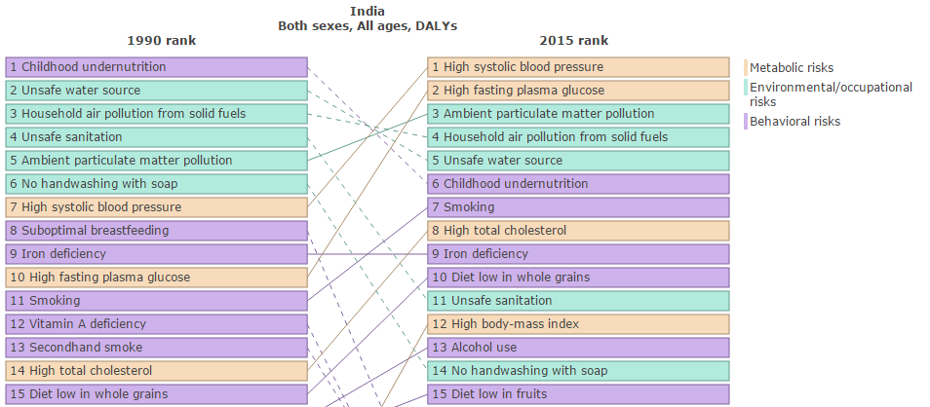
Risk Factors Causing Health Loss in India: 1990 to 2015

Slide 17
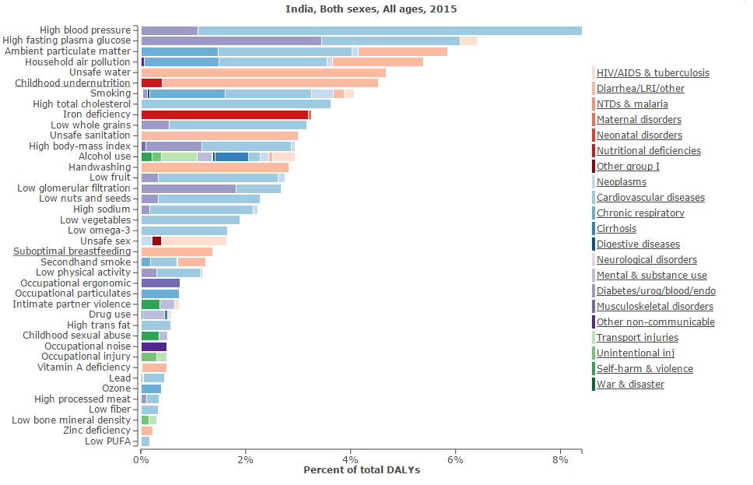
Risk Factors Contribution to Causes of Health Loss in India: 2015

Slide 18
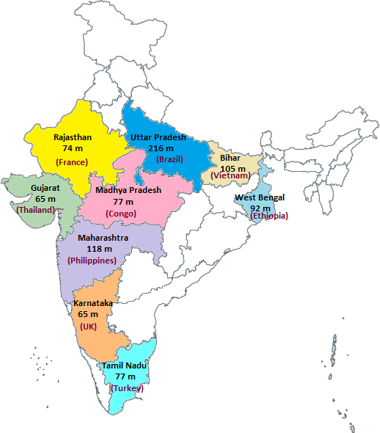
Population of Indian States

Slide 19
State-level Disease Burden Estimates
Joint effort of ICMR, PHFI and IHME, in collaboration with the Ministry of Health and Family Welfare
Robust scientific methods of GBD approach would be utilized as relevant for the states of India
Use the GBD approach to compute estimates for burden of diseases and risk factors for the Indian states
Disaggregated findings by age groups, sexes, rural-urban populations
Use of co-variates to strengthen estimates when data are scanty
Identify major data gaps that could be improved over time
Work with many hundreds of collaborators across the states of India

Slide 20
State Level Estimates
. All available sources of data on mortality, causes of death, morbidity and risk factors will be used.
. Smokeless tobacco included as a risk factor
. Sample Registration System verbal autopsy data.
. Twelve GBD India Expert Groups formed to guide this work, which include over 150 technical experts representing about 90 institutions

Slide 21
State Level Estimates (contd)
- meetings of the expert groups in February 2017 for more substantial state-level findings
- followed by another set of physical meetings in the middle of 2017.
- Launch of the state level study results on November 2017

