Slide 1
Global Burden of Disease: England
Prof. Simon Hay
Director of Geospatial Science
09 November 2016
Instituto Nacional de Salud Publica

Slide 2
Overview
GBD 2010: UK benchmarking
GBD 2013: England subnational
Results
PHE Action Plan
Future work: GBD 2016

Slide 3
Overview
GBD 2010: UK benchmarking
GBD 2013: England subnational
Results
PHE Action Plan
Future work: GBD 2016

Slide 4
GBD 2010: UK Benchmarking release
“Despite real progress in cutting deaths, we remain a poor relative to our global cousins on many measures of health, something I want to change. For too long we have been lagging behind and I want the reformed health system to … turn this shocking underperformance around.”
Jeremy Hunt, Secretary of State for Health in the United Kingdom since 2012 … one survivor of Brexit.

Slide 5
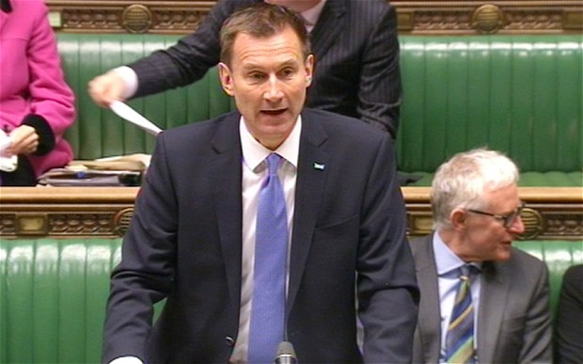
GBD 2010: UK Benchmarking reaction
Dec 2012
IHME & PHE formally commit to work together
Pooled resources
Trained UK staff
March 2013
Publication of Lancet paper benchmarking UK against comparator countries
Jeremy Hunt, Secretary of State for Health, issues a response to GBD findings and a call to action
Development of a national plan based on GBD
Creation of burden of disease unit with capacity building from IHME

Slide 6
Overview
GBD 2010: UK benchmarking
GBD 2013: England subnational
Results
PHE Action Plan
Future work: GBD 2016

Slide 7
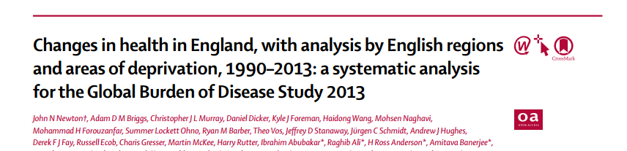
GBD 2013: England subnational
Collaboration with Public Health England
Duncan Selbie, Chief Executive of PHE
John Newton, Chief Medical Officer, PHE
September 2015
Publication of Lancet subnational analysis with disease burden estimates for:
9 regions of England; and 45 deprivation areas

Slide 8
Overview
GBD 2010: UK benchmarking
GBD 2013: England subnational
Results
PHE Action Plan
Future work: GBD 2016

Slide 9
Results - summary
Between 1990-2013, life expectancy in England increased by 5·4 years from 75·9 years to 81·3 years; gains were greater for men than for women.
Rates of age-standardised YLLs reduced by 41·1%, whereas DALYs were reduced by 23·8%, and YLDs by 1·4%.
England ranked better than the UK and the EU15+ means.
Between 1990-2013, the range in life expectancy among 45 regional deprivation areas remained 8·2 years for men and decreased from 7·2 years in 1990 to 6·9 years in 2013 for women.
In 2013, the leading cause of YLLs was ischaemic heart disease, and the leading cause of DALYs was low back and neck pain.
Known risk factors accounted for 39·6% of DALYs; leading behavioural risk factors were suboptimal diet (10·8%) and tobacco (10·7%).

Slide 10
25 leading causes of years of life lost (YLLs) in England, both sexes, 1990, 2005, and 2013 with age-standardized median percent change

Slide 11
YLLs for both sexes, 2013 relative to EU15 & other
Notes:
Age-standardised rates of years of life lost (YLLs) for England and the nine English regions relative to EU15 countries, Australia, Canada, Norway, the USA, Scotland, Northern Ireland, and Wales for both sexes combined in 2013

Slide 12
YLL rates, both sexes, 2013 relative to deprivation
Notes:
Age-standardised rates of years of life lost (YLLs) for England relative to the deprivation levels in the nine English regions for both sexes combined in 2013

Slide 13
25 leading causes of DALYs in England, both sexes, 1990, 2005, 2013
Notes:
The 25 leading GBD level 3 causes of disability-adjusted life years (DALYs) in England, both sexes combined, 1990, 2005, and 2013, with age-standardised median percent change

Slide 14
Proportion of all-cause DALYs attributable to behavioural, environmental and occupational, and metabolic risk factors and their overlaps for all ages in 2013
Notes:
Proportion of all-cause DALYs (A), cardiovascular disease DALYs (B), neoplasm DALYs (C), and injury DALYs (D) attributable to behavioural, environmental and occupational, and metabolic risk factors and their overlaps for all ages in 2013

Slide 15
Proportion of cardiovascular disease DALYs attributable to behavioural, environmental and occupational, and metabolic risk factors and their overlaps for all ages in 2013
Notes:
Proportion of all-cause DALYs (A), cardiovascular disease DALYs (B), neoplasm DALYs (C), and injury DALYs (D) attributable to behavioural, environmental and occupational, and metabolic risk factors and their overlaps for all ages in 2013

Slide 16
DALYs attributed to risk factors in 2013 England, both sexes
Notes:
Disability-adjusted life-years (DALYs) attributed to level 2 risk factors in 2013 in England for both sexes combined (A), men (B), and women (C)

Slide 17
Overview
GBD 2010: UK benchmarking
GBD 2013: England subnational
Results
PHE Action Plan
Future work: GBD 2016

Slide 18
Duncan Selbie, CEO of Public Health England
“Some regions in the country have some of the best health outcomes of any high-income country. If these levels of health could be achieved in the worst performing regions, England could have one of the lowest disease burdens of any developed country. That is the scale of the opportunity we have.”
Source: Public Health England Friday Message, 18 September 2015
Notes:
Link to source: Https://www.gov.uk/government/uploads/system/uploads/attachment_data/file/461782/DS_Friday_message_18_September_2015_final.pdf
Duncan Selbie is referring to the paper "Changes in health in England, with analysis by English regions and areas of deprivation, 1990–2013: a systematic analysis for the Global Burden of Disease Study 2013"

Slide 19
PHE’s plan of action guided by GBD

Slide 20
PHE committed to priorities supported by GBD
Tacking obesity, particularly among children
Reducing smoking and stopping children starting
Reducing harmful drinking and alcohol-related hospital admissions
Ensuring every child has the best start in life
Reducing the risk of dementia, its incidence and prevalence in 65-75 year olds
Tackling the growth in antimicrobial resistance
Achieving a year-on-year decline in tuberculosis incidence

Slide 21
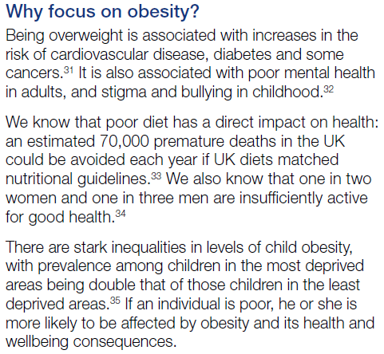
Tackling obesity
Notes:
GBD research on the left, plan of action to respond to these findings on the right

Slide 22
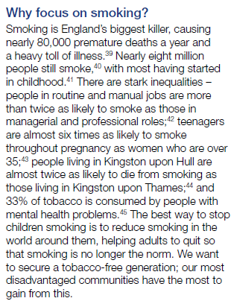
Reducing smoking

Slide 23
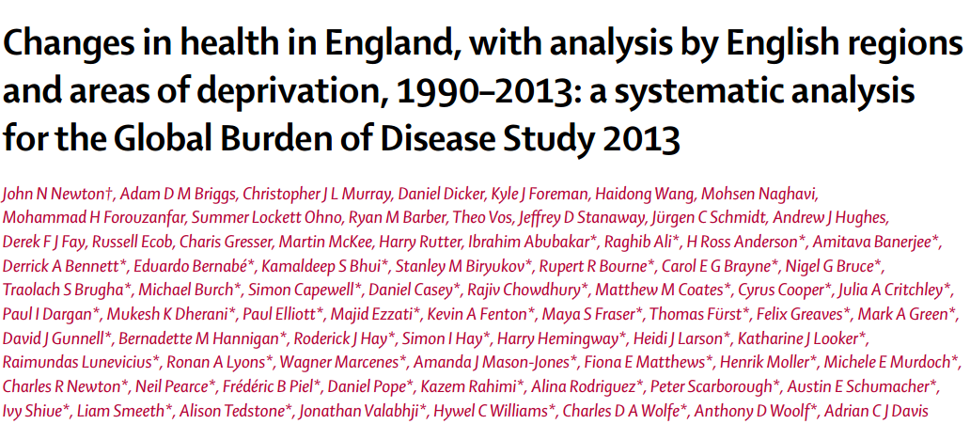
Passing the baton to Public Health England
March 2013 – UK benchmarking paper
42 collaborators
28 from UK
IHME as lead author
September 2015 – UK subnational disease burden
77 collaborators
59 from UK
PHE as lead author

Slide 24
Overview
GBD 2010: UK benchmarking
GBD 2013: England subnational
Results
PHE Action Plan
Future work: GBD 2016

Slide 25
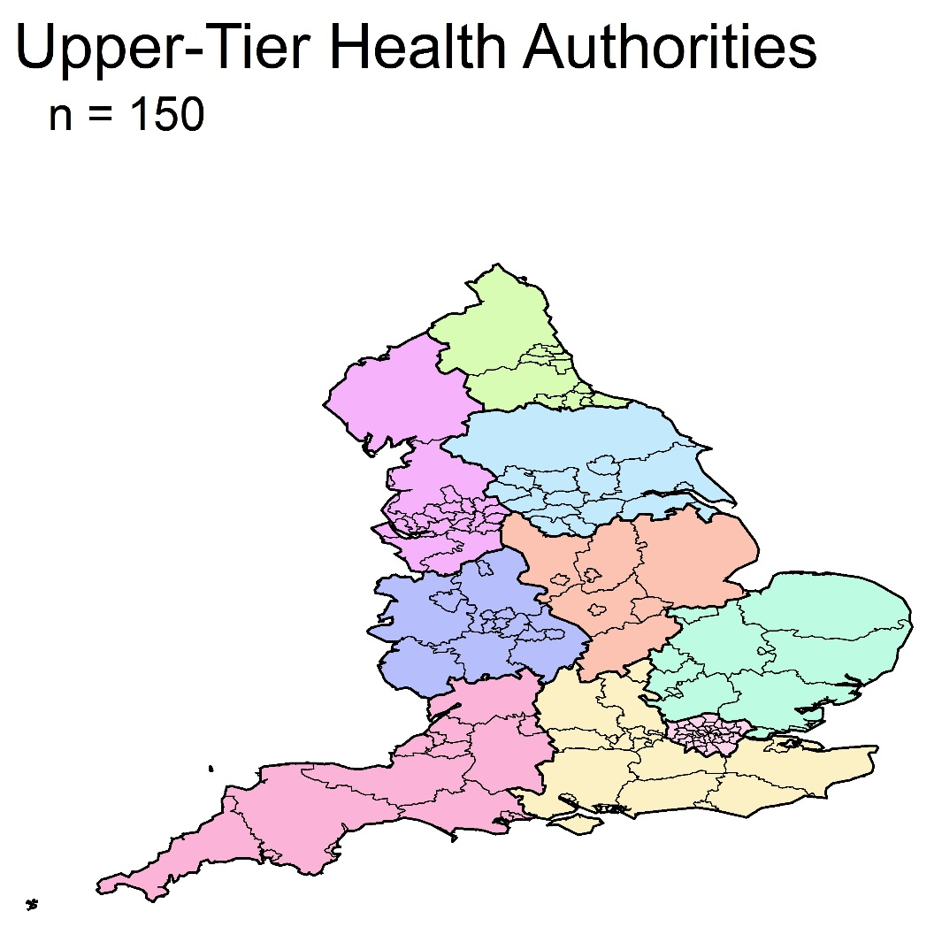
Future directions: GBD 2016
Greater disaggregation
For GBD 2016, England will be one of only two geographies for which new subnational units will be estimated (the other is Indonesia)
Upper tier local authority (UTLA)
This is important as it is the unit at which public health much decision-making and resource allocation are made

